Slide 1
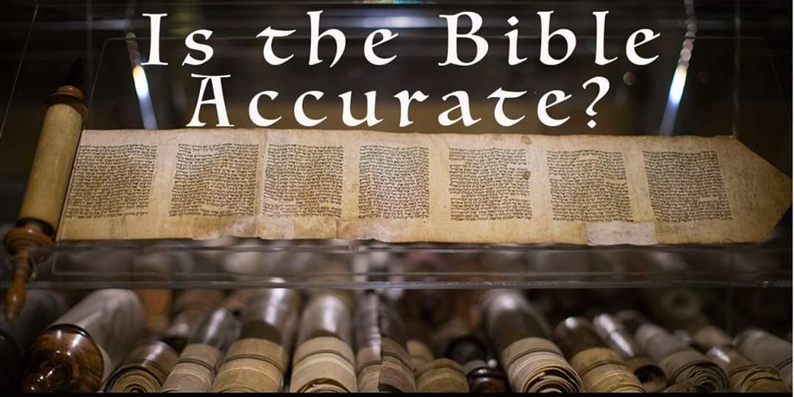

Slide 2
The Historical Accuracy of the Bible
Part One – The Old Testament

Slide 3
Let’s Take Some S.C.A.L.P.S.!
This is serious business
For if we cannot defend the accuracy of the Scriptures then we have, indeed, followed “cunningly devised fables” (2nd Peter 1:16)
Our faith is empty and worthless (1st Corinthians 15:14)
We cannot afford in times such as these to be ill-equipped

Slide 4
1st Peter 3
¹⁴ But even if you should suffer for righteousness’ sake, you are blessed. “And do not be afraid of their threats, nor be troubled.” ¹⁵ But sanctify the Lord God in your hearts, and always be ready to give a defense to everyone who asks you a reason for the hope that is in you, with meekness and fear; ¹⁶ having a good conscience, that when they defame you as evildoers, those who revile your good conduct in Christ may be ashamed. ¹⁷ For it is better, if it is the will of God, to suffer for doing good than for doing evil.

Slide 5
The Bible and History
While the Bible is not a history book, it is a book rooted in history
“Christianity is a very historical religion – it makes specific claims that are open to testing.” – Lee Strobel
Our God stepped into our history and made Himself known to us through His actions from the very beginning
If the historic record He left for us is not accurate and reliable, then how can we depend on anything that it is purported to have come from Him?

Slide 6
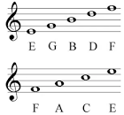
A Memory Aid
Acrostics or Acronyms can help us recall important lessons
The musical scale:

Slide 7

A Memory Aid
All the colors of the rainbow:
Roy G. Biv

Slide 8
A Memory Aid
The tool we want to develop is to help you gain confidence in defending the historical accuracy of the Bible
Since the development of the science of archaeology just over 2 centuries ago, this has become even easier
Tonight we will briefly look at findings in 6 key areas that you can use to bolster your faith in the accuracy of the Scriptural record and to talk with others who may have doubts about the reliability of the Bible

Slide 9
Superiority
The Bible, like every religious writing and tradition, makes claims about the origins and problems besetting mankind
Critics claim that these are all of the same ilk
Some of the most well-known extra-Biblical accounts include the ancient Babylonian creation record recorded on the Enuma Elish and the Ebla tablets
But these gods form the world out of pre-existing matter

Slide 10
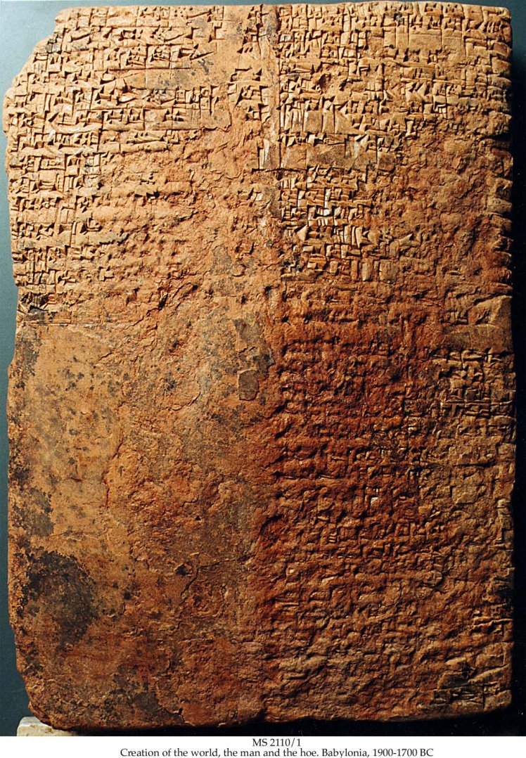
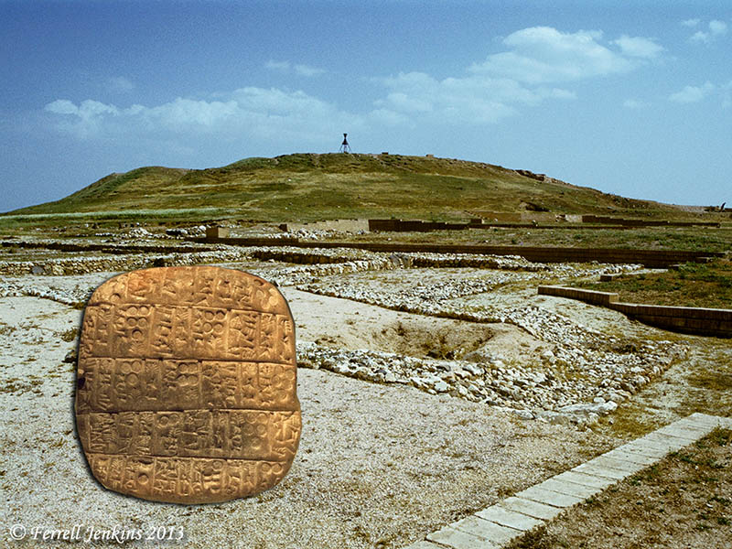
Superiority

Slide 11
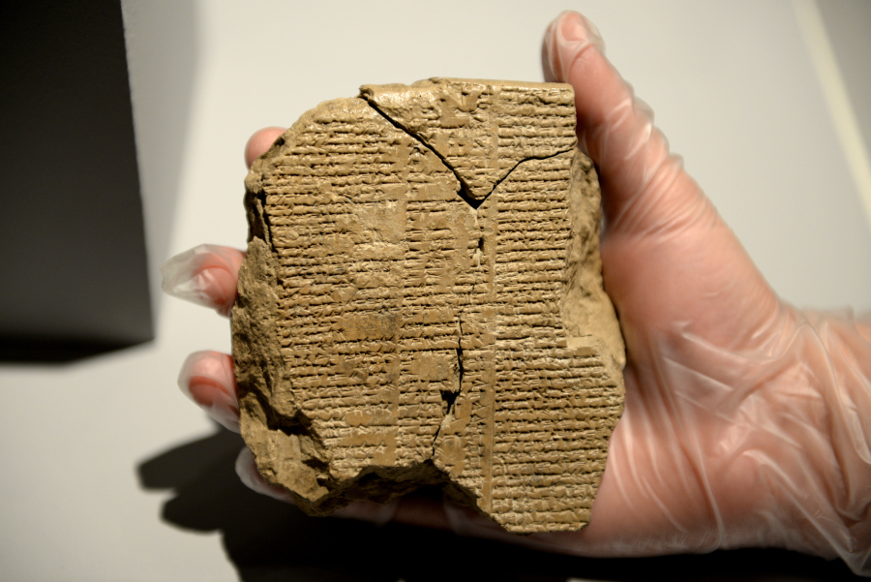
Superiority
They are joined by the famous Gilgamesh Epic with its tale of a great flood
Yet in this story a cruel king who is 2/3rds god who battles with jealous deities only to learn that: “Life, which you look for, you will never find. For when the gods created man, they let death be his share, and life withheld in their own hands.”

Slide 12
Superiority
The god of crafts and wisdom, Enki, warned Utnapishtim (the Babylonian “Noah” figure) about the coming flood and told him to tear down his reed house and prepare a large boat in the shape of a cube
Yet a cube is not seaworthy and would capsize quickly
The boat was built in no more than seven days, during which time Utnapishtim also had to gather the animals from all over the world

Slide 13
Superiority
Although the flood lasted only seven days, it still covered the earth
After a week of rain, the sea and wind calmed, and the boat ground to a halt on Mount Nimush
Flood stories are nearly universal
There are over 270 of them found on every continent
Did your Washington State History class include any local flood stories?

Slide 14
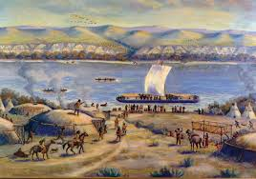
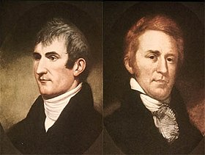
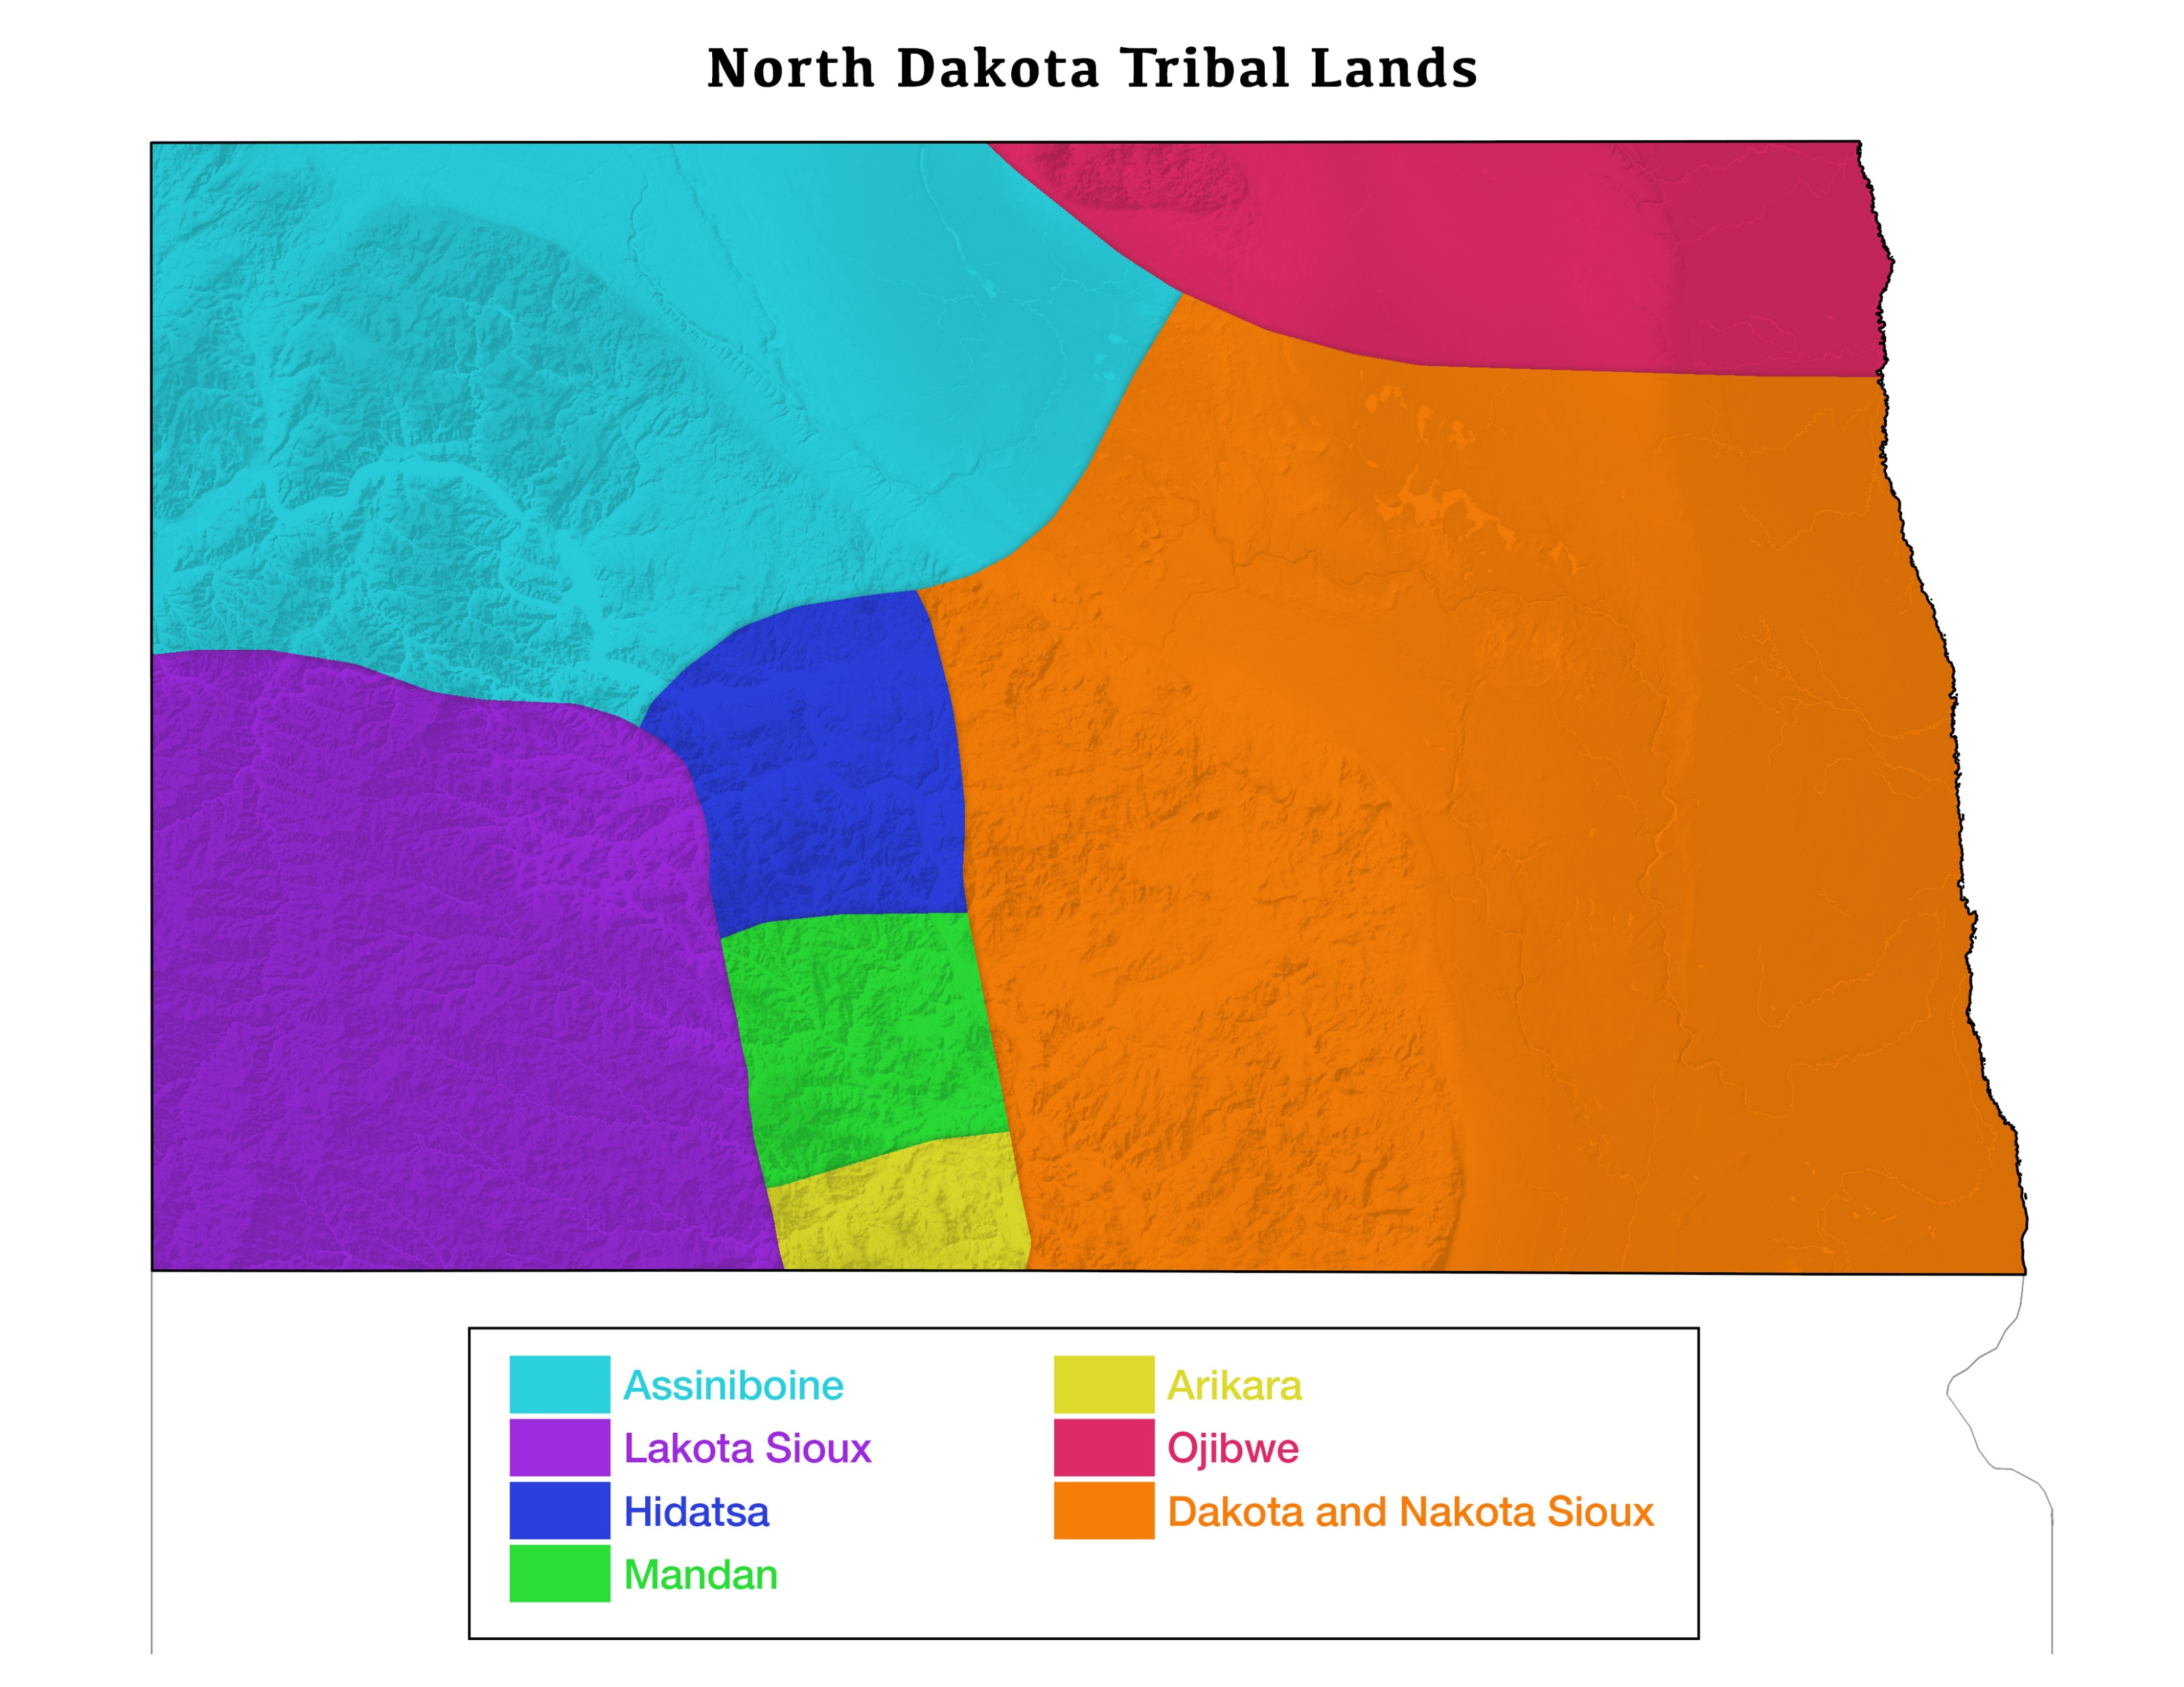
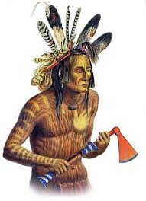
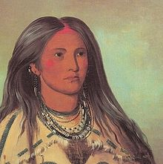
Superiority

Slide 15
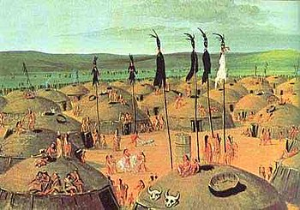
Superiority

Slide 16
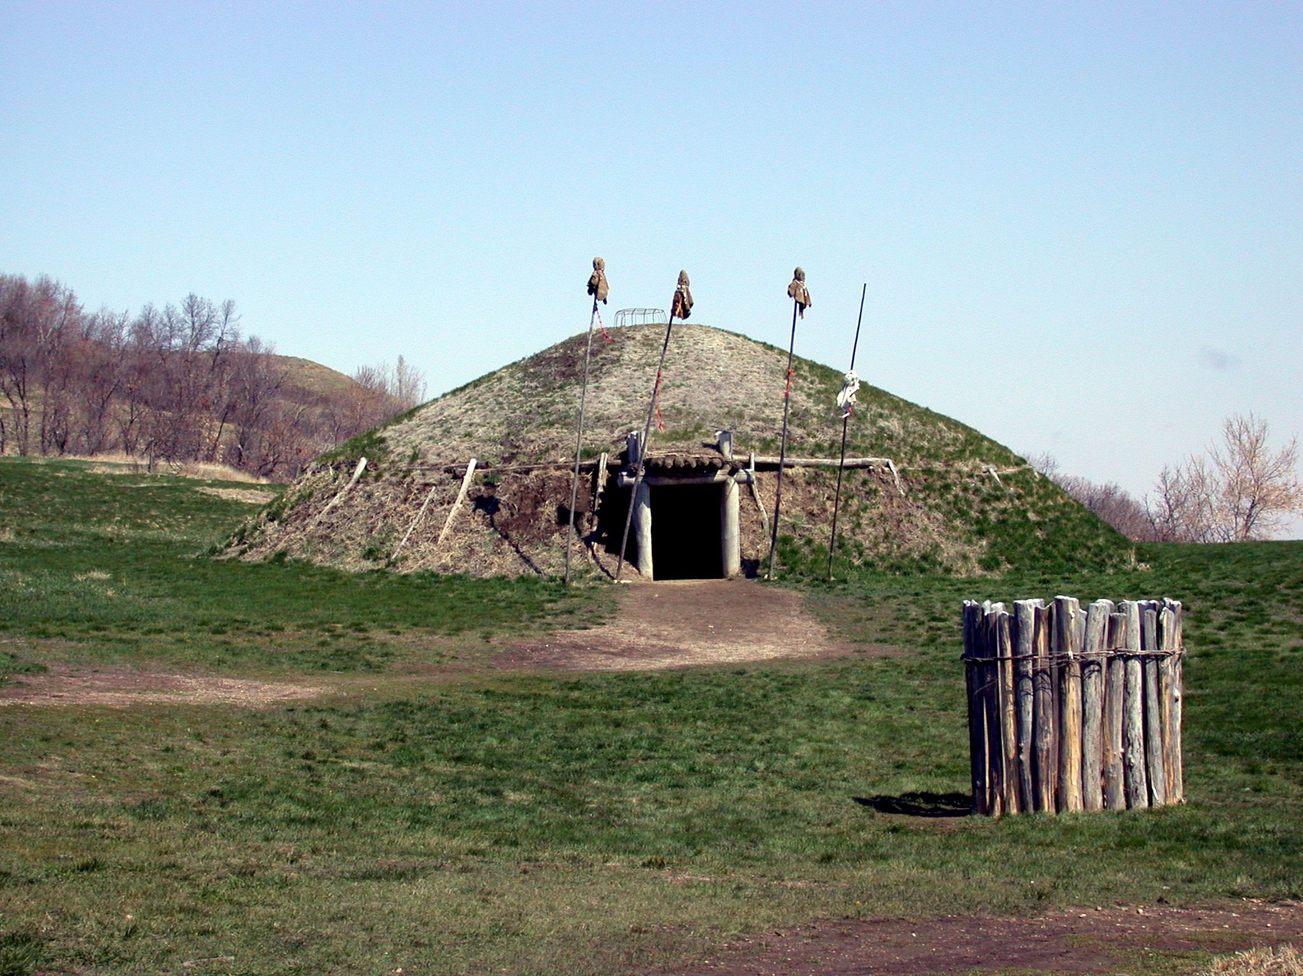
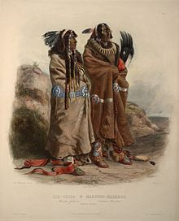
Superiority

Slide 17
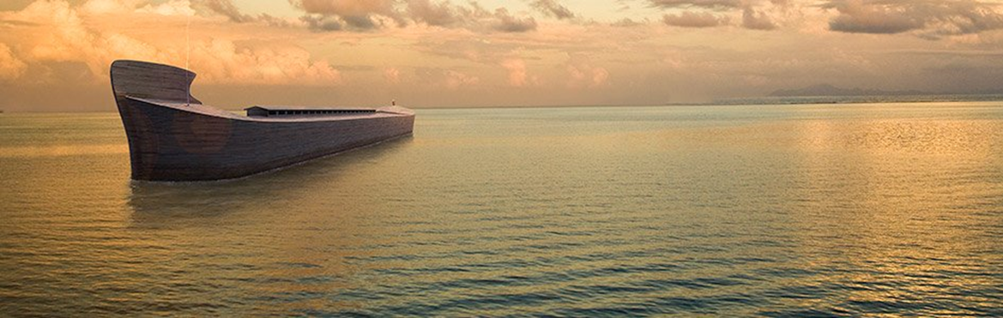
Superiority
In contrast the Bible gives a very reasonable account of all these practical issues
God gave Noah instructions on how to build a rectangular Ark that has been shown experimentally to be very seaworthy
Noah also received a much greater advance warning about the Flood, more than one hundred years and God, not Noah, brought the animals to the Ark
The Bible mentions several natural mechanisms behind the drowning of the world, in a Flood that lasted over a year, which is much more plausible

Slide 18
Superiority
And what a contrast of theme
“But Noah found grace in the eyes of the Lord.” (Genesis 6:8)
“Then God spoke to Noah and to his sons with him, saying: “And as for Me, behold, I establish My covenant with you and with your descendants after you” (Genesis 9:8-9)
But unlike the pagan epics, the Bible records real people with real failures
“And Noah began to be a farmer, and he planted a vineyard. Then he drank of the wine and was drunk, and became uncovered in his tent.” (Genesis 9:20-21)

Slide 19
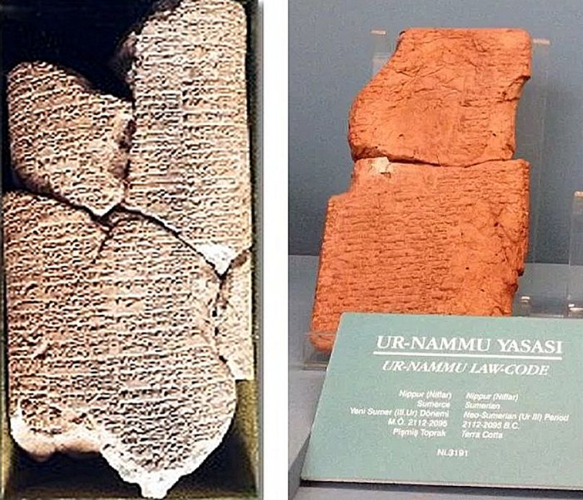
Customs
The Code of Ur-Nammu, the oldest written laws (from ca. the 21st century B.C.) allowed for a husband to take a concubine after waiting in vain for his primary wife to bear a child
The primary wife might even initiate the arrangement
This gives cultural understanding to the record of Abram, Sarai and Hagar in Genesis 16
As well of that of Jacob, Rachel and Bilhah in Genesis 30

Slide 20
Customs
“So the field of Ephron which was in Machpelah, which was before Mamre, the field and the cave which was in it, and all the trees that were in the field, which were within all the surrounding borders, were deeded to Abraham as a possession in the presence of the sons of Heth, before all who went in at the gate of his city.” (Genesis 23:17-18)
This we now know was in complete keeping with Hittite custom
If you sold only part of your parcel, you were still liable to pay the property taxes on the entirety of it
And part of the sale involved the counting of all the trees located on the property

Slide 21
Customs
Although the Hittites are mentioned over 50 times in Scripture, the learned men of the Enlightenment said that they proved the Scriptures to be a myth
Until their capital city was unearthed at Boghazkoy in Turkey by Hugo Winckler in 1906
Its library of over 10,000 clay tablets told the history of one of the greatest empires ever known in the ancient world
Some myth

Slide 22
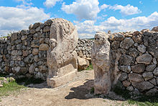
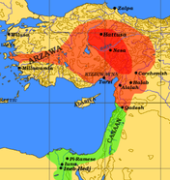
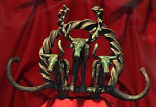
Customs

Slide 23
Customs
What custom was Hosea referring to in chapter 13 (verses 1-2)?
“When Ephraim spoke, trembling, He exalted himself in Israel; But when he offended through Baal worship, he died. Now they sin more and more, And have made for themselves molded images, Idols of their silver, according to their skill; All of it is the work of craftsmen. They say of them, ‘Let the men who sacrifice kiss the calves!’”

Slide 24
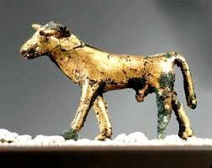
Customs
In 1990 this little guy may have given us the answer
The calf is about 4 1/2 inches long, 4 1/4 inches tall and weighs just under one pound
It was made of bronze and silver and was kept highly polished, so it looked like gold
It was found in Ashkelon and dates to the 2nd millennium B.C.
It is the only one of its type found so far

Slide 25
Additional Information
The archaeologist has often provided additional information which provides important background to the Biblical record
“Belshazzar the king made a great feast for a thousand of his lords and drank wine in the presence of the thousand. While he tasted the wine, Belshazzar gave the command to bring the gold and silver vessels which his father Nebuchadnezzar had taken from the temple which had been in Jerusalem, that the king and his lords, his wives, and his concubines might drink from them. Then they brought the gold vessels that had been taken from the temple of the house of God which had been in Jerusalem; and the king and his lords, his wives, and his concubines drank from them. They drank wine, and praised the gods of gold and silver, bronze and iron, wood and stone.” (Daniel 5:1-4)

Slide 26
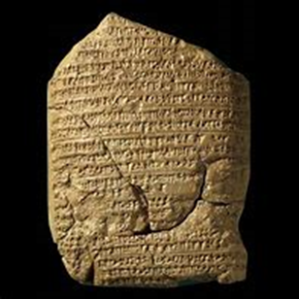
Additional Information
For years skeptics criticized this passage since there was no record of King Belshazzar
But in 1956 the tablets of the Babylonian Chronicles began to be translated
They told how King Nabonidus had gone to Arabia and made Nebuchadnezzar’s grandson Belshazzar co-regent back in Babylon

Slide 27
Additional Information
Which also explains this statement
“The king spoke, saying to the wise men of Babylon, ‘Whoever reads this writing, and tells me its interpretation, shall be clothed with purple and have a chain of gold around his neck; and he shall be the third ruler in the kingdom.’” (Daniel 5:7)

Slide 28
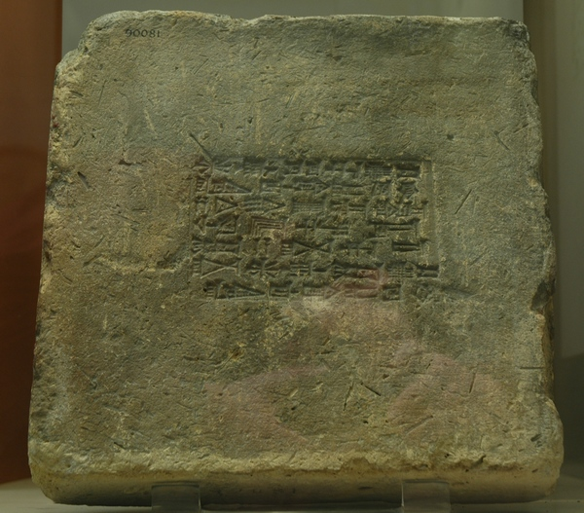
Additional Information
This brick from Babylon can give us insight into this incident from Daniel 4:28-29
“All this came upon King Nebuchadnezzar. At the end of the twelve months he was walking about the royal palace of Babylon. ³⁰ The king spoke, saying, ‘Is not this great Babylon, that I have built for a royal dwelling by my mighty power and for the honor of my majesty?’”

Slide 29
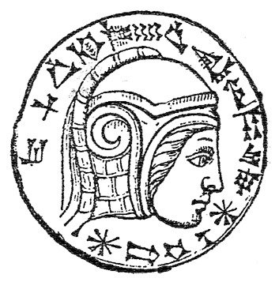
Additional Information
Inscribed on that brick, and all the bricks of the great capital city he had built, was this type of statement:
“Nebuchadnezzar King of Babylon, the chosen one of Nabu and Marduk, son of Nabu-balatsuiskbi, the wise prince.”
Things as mundane as receipts can become significant

Slide 30
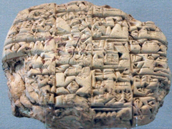
Additional Information
A clay tablet in the British Museum contains a receipt issued by a high official of Nebuchadnezzar for gold donated to a temple in Babylon
“(Regarding) 1.5 minas {i.e. 0.75 kg} of gold, the property of Nabu-sharrussu-ukin, the chief eunuch, which he sent via Arad-Banitu the eunuch to [the temple] Esangila: Arad-Banitu has delivered [it] to Esangila. In the presence of Bel-usat, son of Alpaya, the royal bodyguard, [and of] Nadin, son of Marduk-zer-ibni. Month XI, day 18, year 10 [of] Nebuchadnezzar, king of Babylon.”

Slide 31
Additional Information
Jeremiah 39:3 mentions “Nebo-Sarsekim a chief officer” of Nebuchadnezzar who came into Jerusalem when Jerusalem was besieged and conquered
Nebo-Sarsekim would be the Hebrew equivalent of Nabu-sharrussu-ukin
So even a very minor character in Jeremiah’s record has been verified
Other very major people from Jeremiah’s book have been unearthed in recent years

Slide 32
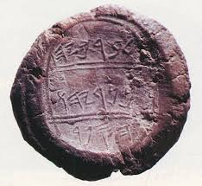
Additional Information
Clay bulla were used to seal documents
This one was from Jeremiah’s scribe, Baruch
One was even found with a fingerprint – it cannot be proven to be Baruch’s

Slide 33
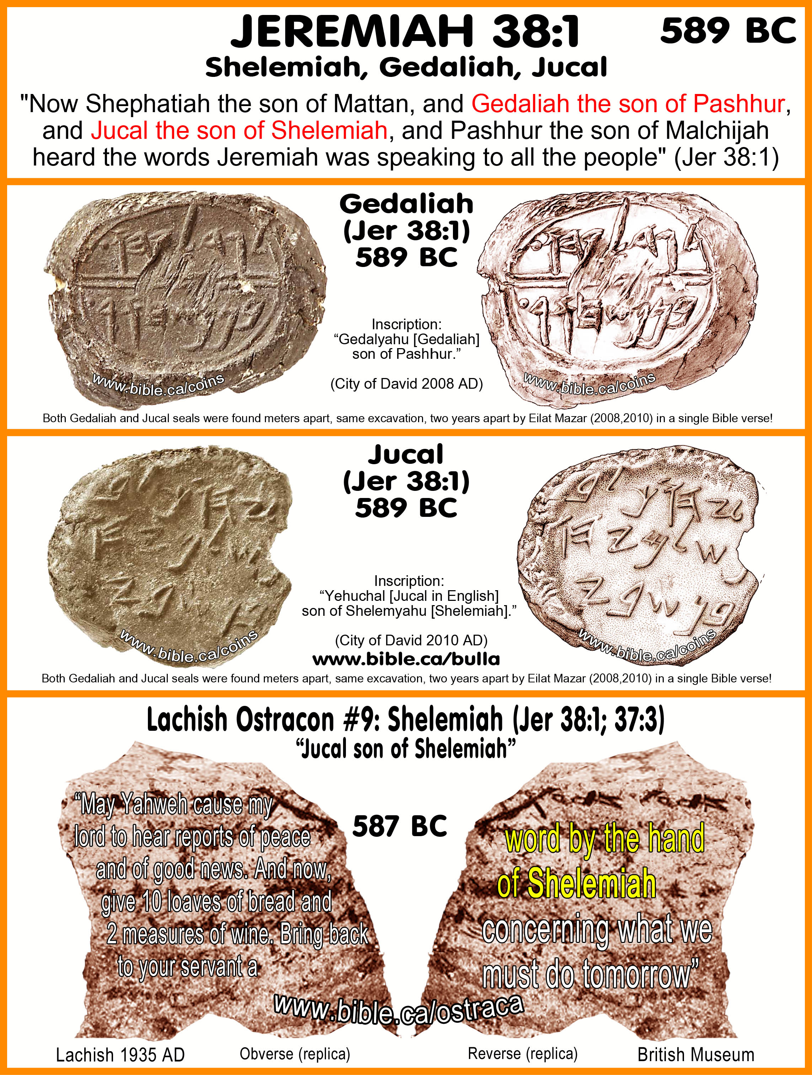
Additional Information

Slide 34
Language
The study of ancient language has bolstered our historic faith in the Scriptures
Skeptics long argued that Moses could not have written the Pentateuch
But Moses had been reared and educated in the court of the Pharaoh of Egypt and would have been familiar with the literature of his times
This would have included Hittite covenantal literature which is very similar to what Moses produced – he was writing in the contemporary style of his times, ca. 1500 B.C.

Slide 35
Language
Similarly, it was argued that the Psalms were composed in the time of the Maccabees in the 3rd century B.C.
But study of the Ugaritic Library shows that David was writing in the poetic style of his era, ca. 1000 B.C.
This does not denigrate the Divine inspiration of these writings
“holy men of God spoke as they were moved by the Holy Spirit.” (2nd Peter 1:21)

Slide 36
Language
Repeatedly, the Scriptural authors use foreign words and phrases that got lost in time that we now know were used properly
The Assyrian titles tartan (commander-in-chief), rabmag, Rabshakeh, and tipsarru are used with confidence and correctly
Yet the Assyrians and their language disappeared from history after the Battle of Carchemish in 605 B.C., so the retention of such obsolete words Is strong indication of the eyewitness nature of the Biblical record

Slide 37
Language
“Now when Abram heard that his brother was taken captive, he armed his three hundred and eighteen trained servants who were born in his own house, and went in pursuit as far as Dan.” (Genesis 14:14)
The word translated “trained servants who were born in his own house” is actually a Hittite word, hanakim, that is only used here
It was not until it was discovered on pottery shards in Egypt that its true meaning was realized, and it was shown to have been used correctly here

Slide 38
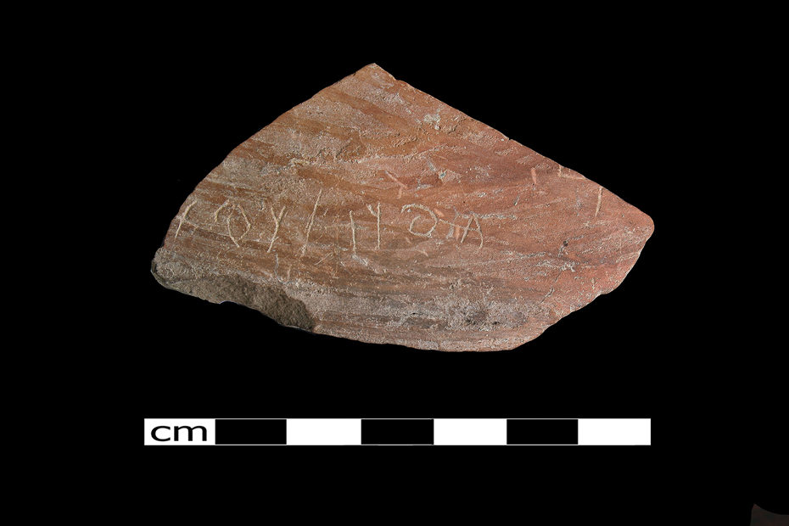
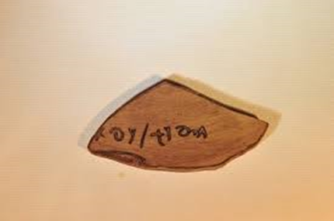
Language
This is the oldest example of Philistine writing yet found
This piece of pottery dates to about 950 B.C.
It was found in the City of Gath
It is a name
Goliath

Slide 39
Prophecy
The Scripture is unique in its being a Book of Prophecy
Archaeology has played its part in verifying the accuracy of the prophetic utterances
“Who says of Cyrus, ‘He is My shepherd, And he shall perform all My pleasure, Saying to Jerusalem, “You shall be built,” And to the temple, “Your foundation shall be laid.” Thus says the Lord to His anointed, To Cyrus, whose right hand I have held—To subdue nations before him And loose the armor of kings, To open before him the double doors, So that the gates will not be shut:” (Isaiah 44:28-45:1 ca. 700 B.C.)

Slide 40
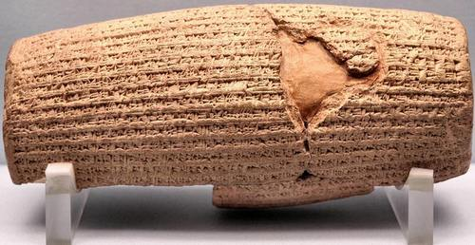
Prophecy
Here is the Cyrus Cylinder created in 539 B.C. recounting the story of how Cyrus conquered Babylon and restored the worship of the old gods and allowed the exiles to return home to worship their deities
It was discovered in 1879

Slide 41
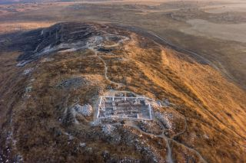
Specific Incidents and People
This large house in central Israel was dated to 3,000 years ago
Its size indicates the existence of a strong organized government
It is 2,500 square feet
It gives strong evidence of the United Kingdom

Slide 42
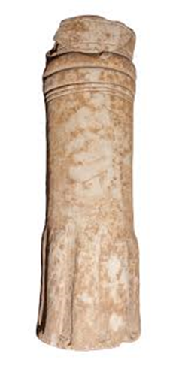
Specific Incidents and People
In 2010 a stone altar was discovered in Jordan engraved in the ancient Moabite language describing the conquest of the city of Ataroth by King Mesha from the Kingdom of Israel
This rebellion of Moab is described in 2nd Kings 3-4

Slide 43
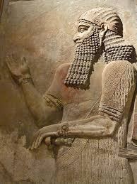
Specific Incidents and People
For years critics dismissed Isaiah’s statement (20:1) “In the year that Tartan came to Ashdod, when Sargon the king of Assyria sent him, and he fought against Ashdod and took it” because they knew of no one named Sargon in the lists of Assyrian kings
Then the palace of Sargon was found in Khorsabad
It even had a wall inscription and a library record of the conquest of the Philistine city of Ashdod

Slide 44
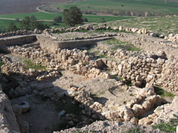
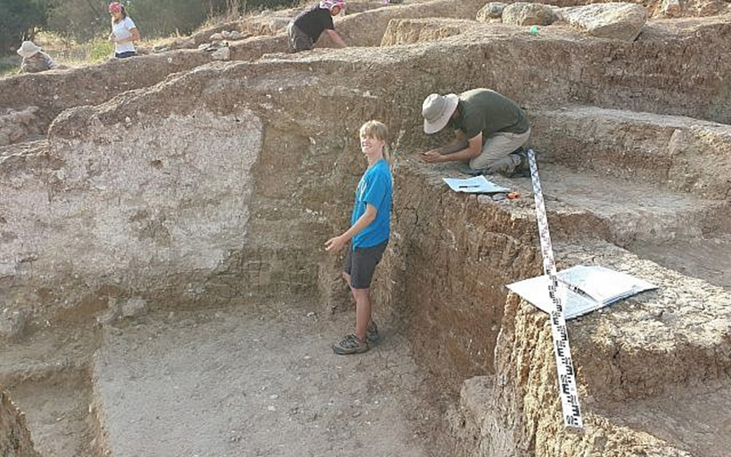
Specific Incidents and People
Going back to another Philistine city, Gath
Several of the buildings that have been excavated are of enormous size
One building in particular gives insight to a famous Biblical story

Slide 45
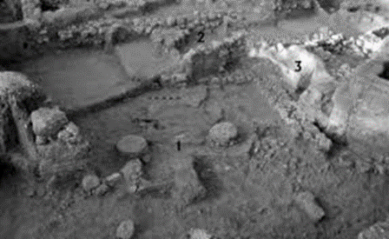
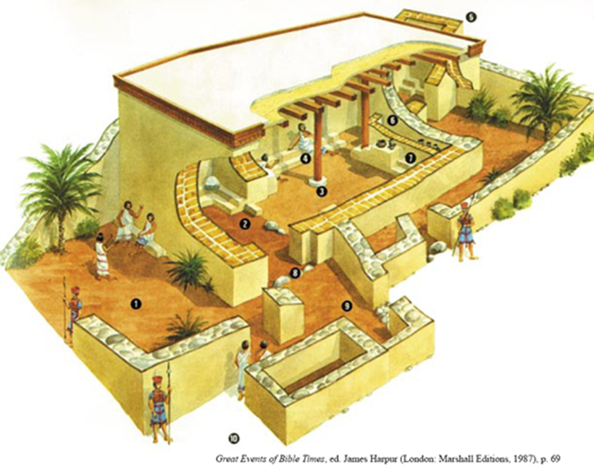
Specific Incidents and People
It was the temple
And it was supported by two main pillars
The Temple of Dagon in Judges 16 was no doubt built in the same fashion
Until Samson brought down the house

Slide 46
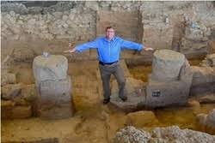
Specific Incidents and People
This temple was not destroyed by a Biblical judge but by another Biblical event
It was flattened by an earthquake that scientists estimate at an 8 on the Richter scale
Two prophets wrote about this big quake
“The words of Amos, who was among the sheepbreeders of Tekoa, which he saw concerning Israel in the days of Uzziah king of Judah, and in the days of Jeroboam the son of Joash, king of Israel, two years before the earthquake.” (Amos 1:1)
Isaiah may have also referred to it in chapters 2 & 6

Slide 47
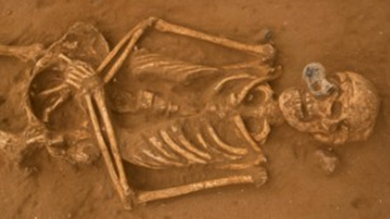
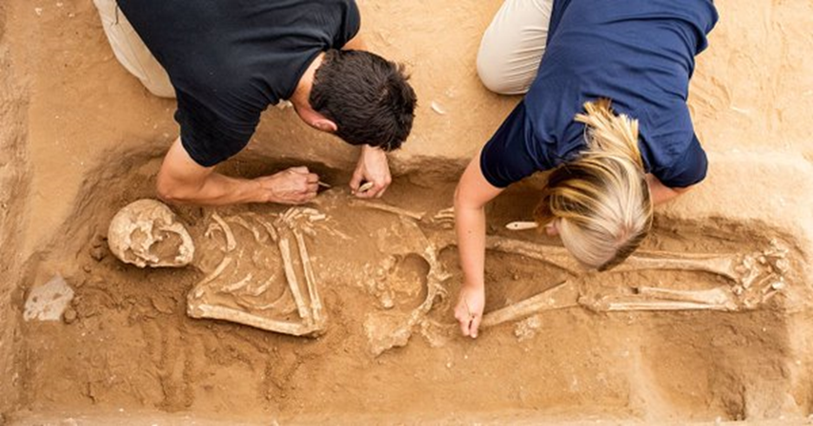
Specific Incidents and People
The first ever Philistine cemetery was also discovered at Gath
DNA was extracted from several of the skeletons
It proved that the Philistines originated from the Aegean region, especially from the primary island in that area, Crete
The Scripture says:
“Israel, I am the Lord God, and the Ethiopians are no less important to me than you are. I brought you out of Egypt, but I also brought the Philistines from Crete and the Arameans from Kir. (Amos 9:7 CEV)

Slide 48
Specific Incidents and People
“Before the king of Egypt attacked the town of Gaza, the Lord told me to say to the Philistines: … You refugees from Crete, your time has now come, and I will destroy you. None of you will be left to help the cities of Tyre and Sidon.” (Jeremiah 47:1, 4 CEV)
(They could have saved a lot of money on their subscription to Ancestry.com!)
The modern science of DNA testing has also made other interesting discoveries

Slide 49
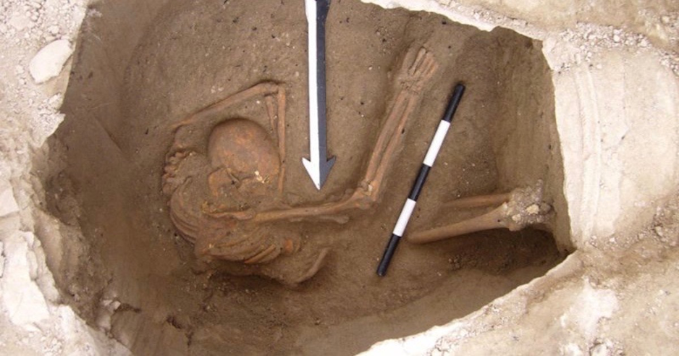
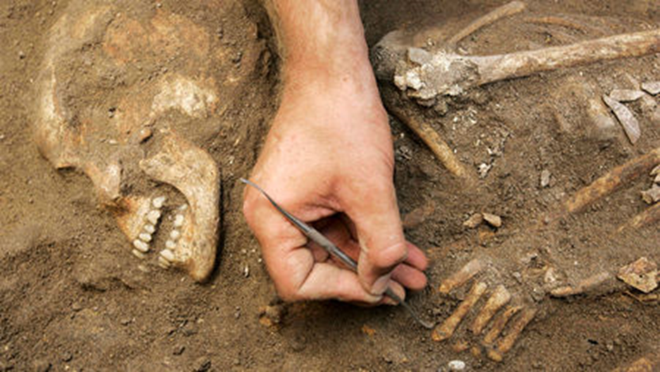
Specific Incidents and People
Researchers sequenced the DNA genomes of 5 Canaanite skeletons found outside ancient Sidon
They then tested 99 Lebanese individuals and found that 90% of their DNA comes from the Canaanites
Skeptics were quick to crow that science had disproven the Bible

Slide 50
Specific Incidents and People
Quite the contrary – it actually proves the Biblical record
Judges chapter 1 lists all the places that the Israelites failed to take from the Canaanites (and it is a long list!)
Verse 31 says: “Nor did Asher drive out the inhabitants of Acco or the inhabitants of Sidon, or of Ahlab, Achzib, Helbah, Aphik, or Rehob.”
So if the Canaanites were living in Sidon 3,500 years ago it should be no surprise that they are still living there today!

Slide 51
Specific Incidents and People
More than that, it reinforces the true character and nature of our God
“The Lord is not slack concerning His promise, as some count slackness, but is longsuffering toward us, not willing that any should perish but that all should come to repentance.” (2nd Peter 3:9)
Even in the Scriptural record there were Canaanites who realized who God was such as the Gibeonites and Rahab
But in the modern era, until the rise of the radical Islamicists, Lebanon had the largest Christian community in the Middle East

Slide 52
The Historical Accuracy of the Bible
Part Two – The New Testament

Slide 53
Superiority
As mentioned, the Bible is unique among the books claiming to be inspired revelations in several ways
The most outstanding is that it is a book of prophecy
But in this area of historicity, it is unparalleled
To prove its superiority, lets compare it with another book that claims to be a gospel of Jesus Christ and purports to record historical events from ca. 2200 B.C. to A.D. 421

Slide 54
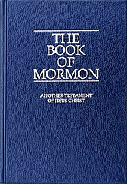
Superiority
I refer, of course, to The Book of Mormon
The Book of Mormon reportedly contains the stories of three different groups which sailed to the Americas from the Middle East
The story of Jaredites, as told in the Book of Ether, came to the new world at the time of the tower of Babel
They were instructed to build eight barges
Their journey took 344 days

Slide 55
Superiority
After years of occupying the land and numbering in the millions, their civilization was destroyed by war
The last survivor, Coriantumr, was found by the Mulekites sometime before 200 B.C.
The Mulekites came to America from Jerusalem in 586 B.C. led by the last living son of Zedekiah, Mulek
Although they lived in America during the same period as the Nephites and Lamanites, they did not encounter them until around 200 B.C.
They then became amalgamated with the Nephites

Slide 56
Superiority
The two main groups in the Book of Mormon are the Nephites and the Lamanites
The story tells of a family group led by an Israelite prophet named Lehi who had been warned by God to flee Jerusalem at 600 B.C.
He and his family make their way to the southern part of Arabia where they build a ship to sail across the Pacific Ocean to America
Two of his sons, Nephi and Laman struggle for leadership
This leads to the division of the group into two warring factions, the Nephites (usually the good guys) and Lamanites (usually the bad guys)

Slide 57
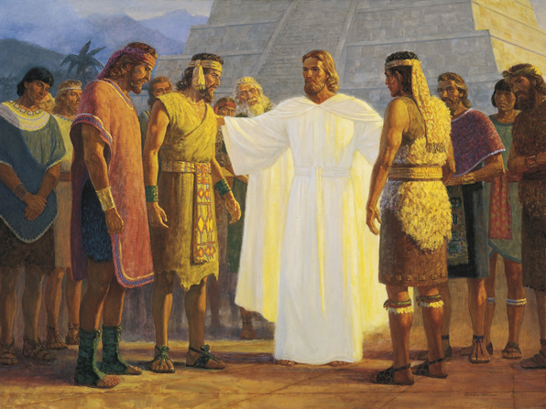
Superiority
The Book of Third Nephi is of particular importance because it contains an account of a visit by Jesus to the Americas sometime after His ascension during which He repeated much of the same doctrine and instruction given in the Gospels and established an enlightened, peaceful society which endured for several generations, but which eventually broke into warring factions again

Slide 58
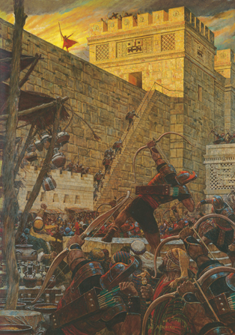
Superiority
The last battle between the two groups, in A.D. 421, wipes out almost all the Nephites
Moroni, the last surviving Nephite, buries the records of his civilization in the hill Cumorah
Hundreds of years later, Joseph Smith is directed to the spot by Moroni (some records say Nephi), now a resurrected being who has become an angel

Slide 59
Superiority
Looking only at the historical record, how does The Book of Mormon stand up to what we have already seen about the Bible?
It covers primarily the same time as the end of the Old Testament and throughout the entire New Testament
Yet none of the cities mentioned in the book can be located
None of the battlefields have been uncovered
Not one of the coins or artifacts has been dug up

Slide 60
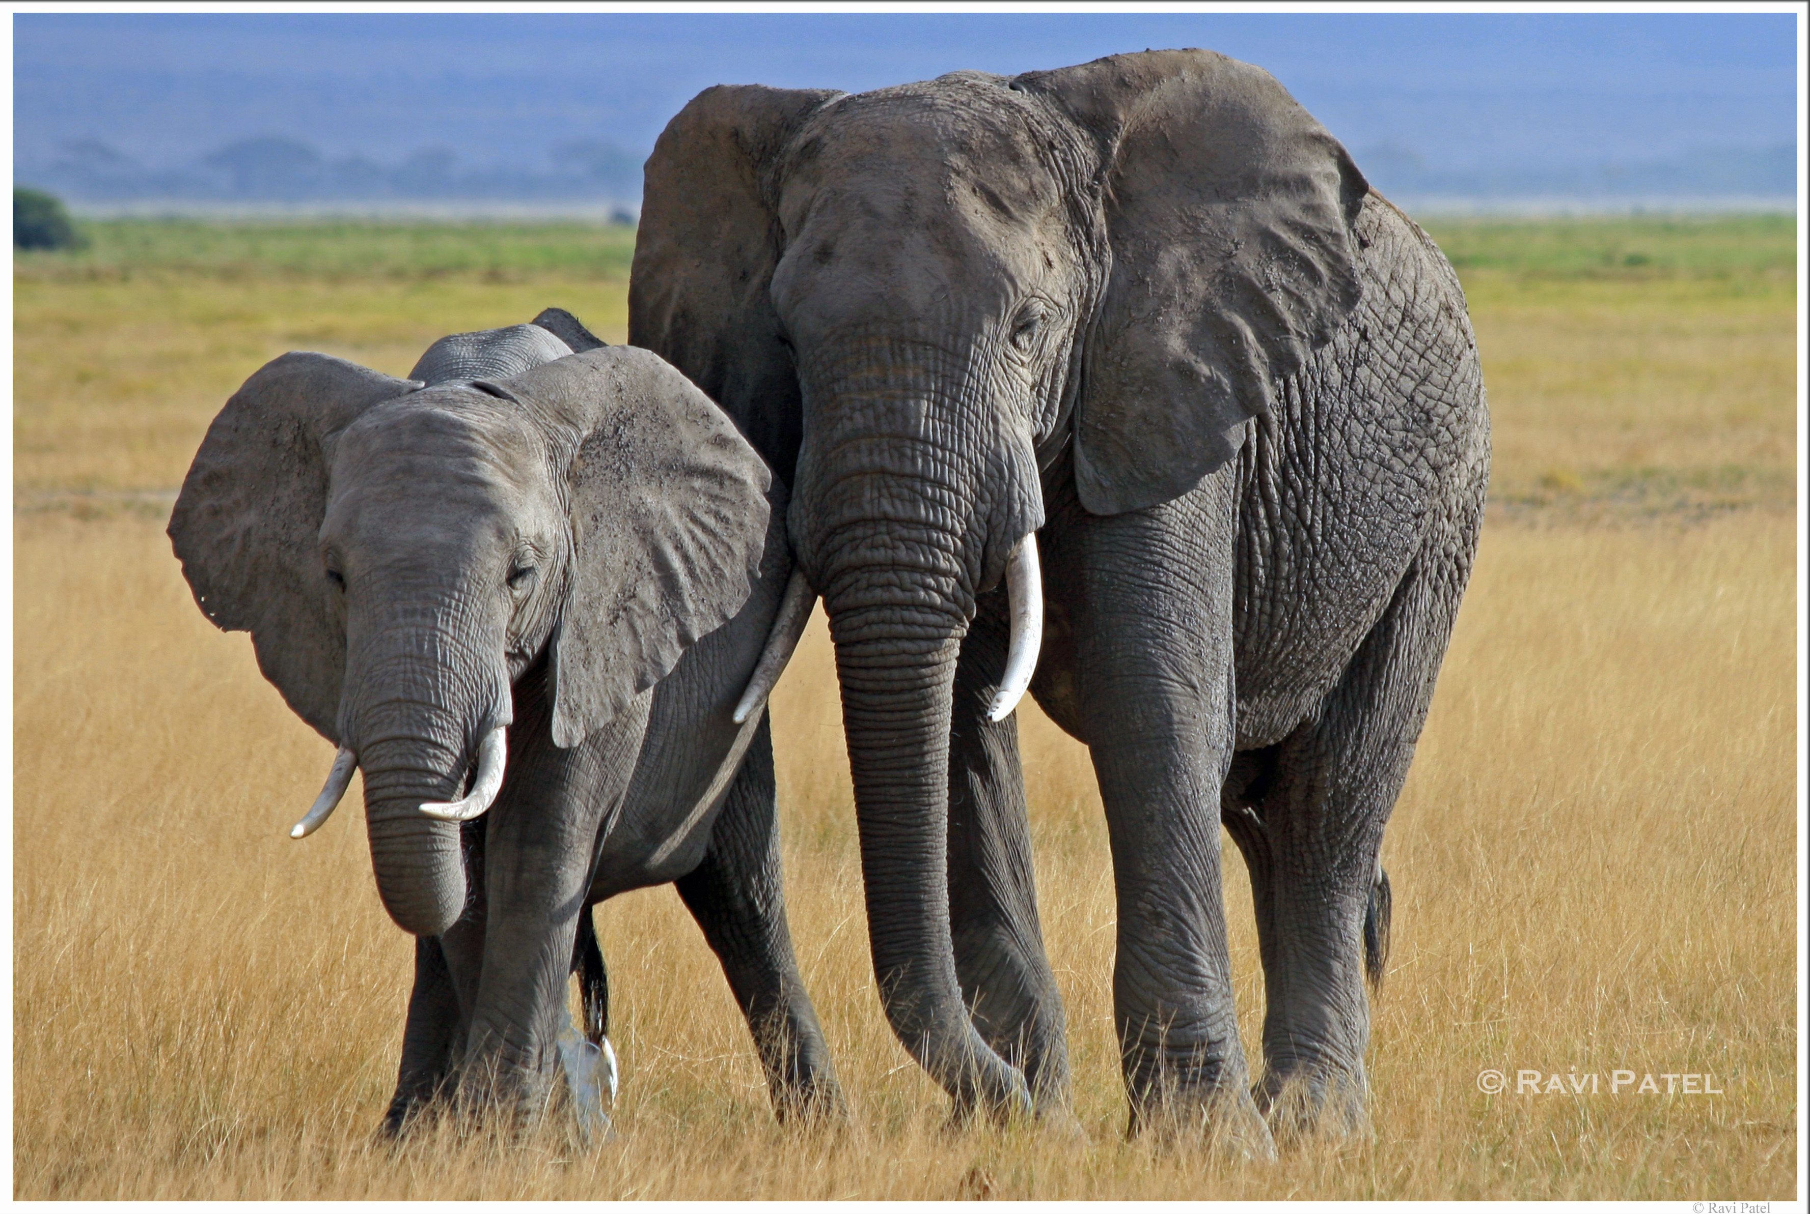
Superiority
There are numerous known historical inaccuracies
The Book of Mormon mentions: wheat (Mosiah 9:9), horses (1 Nephi 18:25), chariots (Alma 18:9-11; 20:6; 3 Nephi 3:22), cows (Enos 21), elephants (Ether 9:19), silk (Alma 1:29; 4:6; Ether 9:17), linen (Mosiah 10:5; Helamon 6:13; Ether 10:24), money-pieces of gold and silver (Alma 11:3-20), and steel (2 Nephi 5:15; Jarom 1:8; Ether 7:9)
None of these items were known in the Americas before the arrival of the Spaniards in the 1500s (if ever )

Slide 61
Superiority
The central character of the New Testament and His teaching outshines those of other religious or philosophical traditions in ways that are beyond comparison
Jesus is superior to all others in that He claims (and we believe sufficiently proves) that He is fully man and fully God
He is the only One to come into this world as He did and to live a perfect and sinless life
His is the only message that presents a way for mankind to find redemption from sin

Slide 62
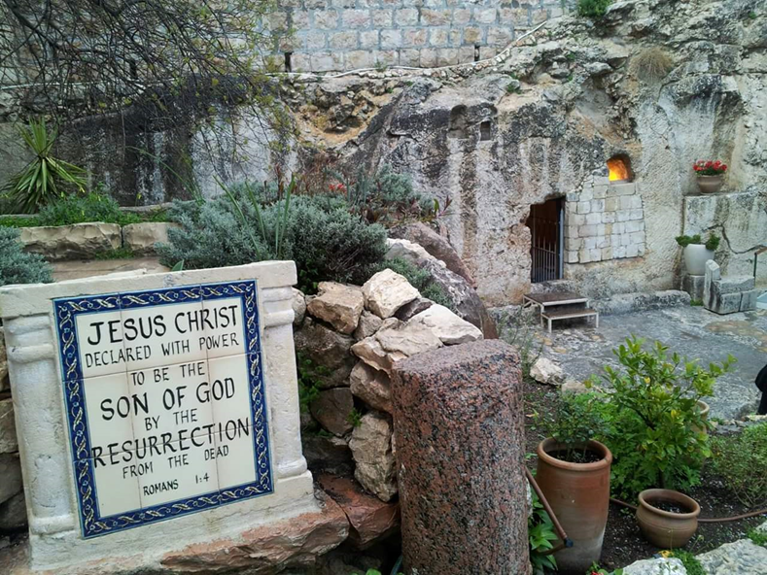
Superiority
He is the only One who offered Himself as the sacrifice necessary for mankind
Jesus Christ is the only religious leader to have risen from the dead

Slide 63
Superiority
Entire books have been written on the superiority of the teaching of Jesus, let us just touch on a few examples
“…whatever you want men to do to you, do also to them…” (Matthew 7:12) is often called the Golden Rule
Many have seen in it similarities to the ethical teachings of others
The esteemed rabbi Hillel (ca. 110 B.C.-A.D. 10) said, "What is hateful to thee, do not do to another," and he was but repeating a passage in the book of Tobit, " What thou hatest, do to no one"

Slide 64
Superiority
A Greek biographer of Aristotle relates that being asked how we should behave towards our friends he answered, "As we should wish them to behave towards us“
Socrates had previously said, " What you are angry at when inflicted on you by others, this do not do to others"
A similar negative form of the precept is also frequently quoted from Confucius, "What you do not like when done to yourself, do not do to others“
But Jesus made it a positive with no limits as to whether towards friends or enemies

Slide 65
Superiority
The Jewish traditions had run everything into rules which they called making a fence around the law, to encompass it with all manner of minute directions, which would keep men away from breaking the law
Jesus evidently set himself against this disposition
He did not wish his followers to be burdened by stiff and narrow rules; he taught them principles, which are at once more comprehensive and more flexible
And the thinking which is required in order to apply principles brings with it a most valuable part of our moral discipline

Slide 66
Superiority
The great motive which Jesus connects with his ethical teachings is Love
The love of God is to be supreme
The love of one's neighbor is to be in balance with the love of self
This makes a distinct recognition of self-love as essentially right
In sinful beings self-love constantly gravitates downwards towards selfishness
The remedy is to keep it balanced by love of our neighbor, while love to God is exalted above both, and holds them in symmetrical relation

Slide 67
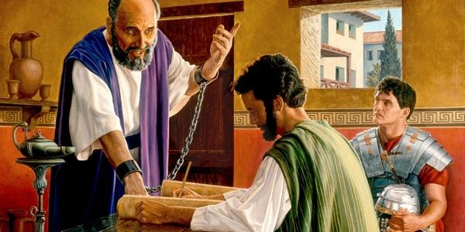
Customs
An understanding of Jewish and Roman customs and culture in the first century can give us a greater and deeper understanding of so many passages in the New Testament

Slide 68
Customs
“Put on the whole armor of God, that you may be able to stand against the wiles of the devil.” (Ephesians 6:11)
“You therefore must endure hardship as a good soldier of Jesus Christ. No one engaged in warfare entangles himself with the affairs of this life, that he may please him who enlisted him as a soldier.” (2nd Timothy 2:3-4)
“Only Luke is with me.” (2nd Timothy 4:11)

Slide 69
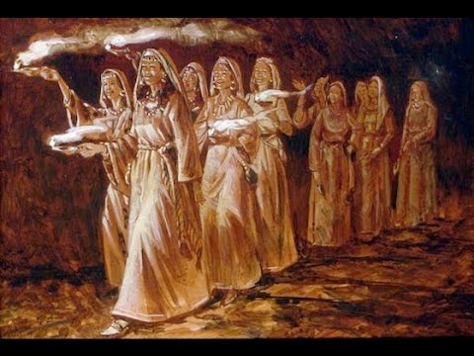
Customs
One of the most important customs to understand is that surrounding the rituals of betrothal and marriage
Christ many times used them to picture important truths about His relationship with His church
In Matthew 25 He gave the parable of the 10 virgins

Slide 70
Customs
This imagery is consummated in Revelation 19:7-9
“Let us be glad and rejoice and give Him glory, for the marriage of the Lamb has come, and His wife has made herself ready. And to her it was granted to be arrayed in fine linen, clean and bright, for the fine linen is the righteous acts of the saints. Then he said to me, “Write: ‘Blessed are those who are called to the marriage supper of the Lamb!’ ”
Putting the whole ritual together gives a beautiful picture of Jesus’ love for and plan for His Bride, the Church

Slide 71
Customs
At the time of Christ, there were different customs with respect to women walking in a funeral procession
In Judea, the area around Jerusalem, the custom was for the women to walk behind the funeral procession; the casket led the way with the women following behind
However, in the Galilee region, the custom was reversed; the women walked in front of the funeral procession with the casket trailing behind
The description given by Luke of the procession in Nain of the funeral of the widow’s son demonstrates the minute accuracy of his account (See Luke 7:11-15)

Slide 72
Customs
It takes something of momentous importance to change long-standing customs
The 2009-2010 exploration of a 1st century tomb first found in 1981 now 6 ½ feet under the patio of a condo in Jerusalem gives just such an indication of a cultural shift that sheds light on the historical veracity of the New Testament record
Jewish burial customs of the time were to place the body, wrapped in burial cloths and spices, in a tomb, and then after a year, to gather the bones and place them in a limestone ossuary (bone box) which would be stored in the tomb with other family members’ ossuaries

Slide 73
Customs
Among the approximately 2000 ossuaries that have been recovered, only 650 have any inscriptions on them and less than a dozen ossuaries from the period have epitaphs and these messages usually have to do with warnings not to disturb the bones of the dead while others mention the name of the person interred therein
None of them have anything at all like the inscriptions and carvings found on the ossuaries in this tomb

Slide 74
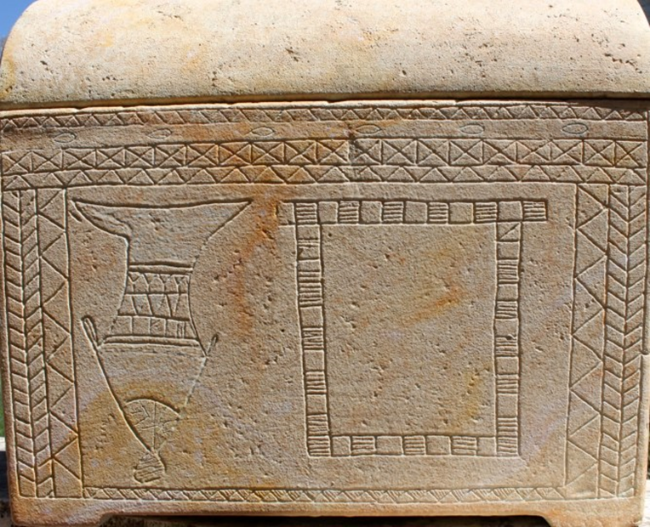
Customs
On one ossuary there is a large fish large image with a figure seeming to come out of its mouth
On one side is the tail of a fish disappearing off the edge of the box, as if it is diving into the water

Slide 75
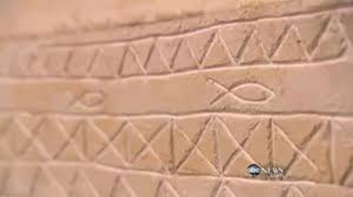
Customs
There are small fish images around its border on the front facing, and on the other side is the image of a cross-like gate or entrance which could be interpreted as the notion of entering the "bars" of death, which are mentioned in the Jonah story

Slide 76
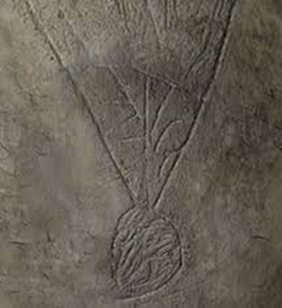

Customs
Discoverers of the ossuary claim the lines in what would be the fish's mouth, if this is an image of a fish, spell the Hebrew word "YONAH," (the Hebrew form of Jonah)

Slide 77
Customs
Another ossuary contains several lines of a Greek inscription which has been translated either as: "O Divine Jehovah, raise up, raise up," or "The Divine Jehovah raises up from [the dead]“
It is believed that this is the oldest Christian burial spot ever found and it pre-dates A.D. 70
Besides its clear statement of faith in the power of God to raise the dead (something not found in the Jewish tombs of the time), the Jonah motif clearly hearkens to an expression of faith in Jesus' resurrection based on the words of Jesus, the “sign of Jonah” - the sign that he would escape the bonds of death

Slide 78

Additional Information
Why did the crowds wave palm branches at the Triumphal Entry?
The palm frond had become a patriotic symbol of an independent and strong Israel
It was used on coins minted during the time of the Maccabees (as on this coin from the reign of Hyrcanus I, 135-194 B.C.)

Slide 79
Additional Information
Solomon’s Temple is described with palm decorations
“Then he carved all the walls of the temple all around, both the inner and outer sanctuaries, with carved figures of cherubim, palm trees, and open flowers.” (1st Kings 6:29)
And, according to the Babylon Talmud, the walls of the second temple were also carved throughout with cherubim, palms, and open-faced flowers

Slide 80
Additional Information
It was common practice during the Festival of Tabernacles/ Booths (Sukkoth) for Jewish people to celebrate by living in temporary booths and rejoicing with leafy branches
This specific festival was a reminder of God's faithfulness in the wilderness and of God's soon promise for the Messiah to come
It was during this Feast of Tabernacles that they would declare aloud the following verses from Psalm 118: "Lord, save us! Lord, grant us success! Blessed is he who comes in the name of the Lord. From the house of the Lord we bless you" (Psalm 118: 25-26, NIV)
"Lord Save us" translates to "Hosanna"

Slide 81

Additional Information
After quoting the traditional Sukkot Psalm, the worshippers drive their point home by adding: “Hosanna to the Son of David!” (Matthew 21:9), and “Hosanna! Blessed is he who comes in the name of the Lord, even the King of Israel!” (John 12:12)
Palm branches were a symbol of power and victory over enemies to the Romans
In Roman athletic competitions, the winners were awarded palm branches as a symbol of strength
Even the Romans understood what was going on

Slide 82
Language
Paul seems to have borrowed from Graco/Roman authors
An example may be in 2nd Corinthian 3:3 where he wrote: “you are an epistle of Christ, ministered by us, written not with ink but by the Spirit of the living God, not on tablets of stone but on tablets of flesh, that is, of the heart.”
This is an apparent allusion to Pericles’ Funeral Oration (431 B.C.), when the great statesman told the Athenians: “In foreign lands there dwells also an unwritten memorial of them, graven not on stone but in the hearts of men.”

Slide 83
Language
Paul’s Statement | Pagan Source
"kick against the pricks“ (actually Christ to Paul in Acts 9:5) | “Kick against the pricks“ Aeschylus in Agamemnon (ca. 450 B.C.)
"For in him we live, and move, and have our being;“ (Acts 16:28 on the Areopagus) | "For in him we live and move and have our being“ Epimenides in a Hymn to Zeus (ca. 600 B.C.)
“For we are also his offspring.“ (Acts 16:28) | “We are also his [Zeus’] offspring.” Aratus in Phaenomen (ca. 300 B.C.)

Slide 84
Language
Paul’s Statement | Pagan Source
“For the good that I would I do not: but the evil which I would not, that I do.“ (Romans 7:19) | “The good that I would I do not; but the evil which I would not do, that I do" Euripides in Hippolytus (ca. 425 B.C.)
“Bad company corrupts good character.“ (1st Corinthians 15:33) | “Bad company corrupts good character“ Menander (ca. 350 B.C.) who probably took it from Euripides according to Socrates
"Cretans are always liars, evil brutes, lazy gluttons.“ (Titus 1:12) | "Cretans are always liars, evil brutes lazy gluttons." Epimenides in Cretica (ca. 600 B.C.)

Slide 85
Language
And a doubtful connection: “work out your own salvation with fear and trembling.“ (Philippians 2:12) to which some see a connection with "Work out your own salvation with diligence“ in the Mahaparinibbana sutta Buddhist scriptures
Clearly, Paul quoted unbelievers, but not in support of their inspiration or their wisdom, rather to promote the truth of Christianity
He spoke in cultural terms that would be easily understood by his audience

Slide 86

Prophecy
"He who has not seen Herod's building, has never in his life seen a truly grand building." (Talmud-Bava Basra 4a)
The great Jewish/Roman historian Josephus described the magnificence of the Temple with these words in his history of the Jewish War:

Slide 87
Prophecy
“Viewed from without, the Sanctuary had everything that could amaze either mind or eyes. Overlaid all round with stout plates of gold, the first rays of the sun it reflected so fierce a blaze of fire that those who endeavored to look at it were forced to turn away as if they had looked straight at the sun. To strangers as they approached it seemed in the distance like a mountain covered with snow; for any part not covered with gold was dazzling white...”

Slide 88


Prophecy
No wonder the disciples were filled with wonder as they left the holy mount that day
No wonder they were even more amazed when their Master said: “Do you not see all these things? Assuredly, I say to you, not one stone shall be left here upon another, that shall not be thrown down.” (Matthew 24:2; c.f. Mark 13:2, Luke 19:44 & Luke 21:6)

Slide 89
Prophecy
The Luke 21 passage contains additional predictions
“But when you see Jerusalem surrounded by armies, then know that its desolation is near. Then let those who are in Judea flee to the mountains, let those who are in the midst of her depart, and let not those who are in the country enter her. For these are the days of vengeance, that all things which are written may be fulfilled.” (20-22)

Slide 90


Prophecy
Just last year archaeologists uncovered the remains of the base of the siege tower built by the Roman troops under General Titus that sealed the fate of Jerusalem in A.D. 70
They also discovered over 70 ballista and sling stones in front of the wall signifying the intensity of the battle

Slide 91



Prophecy
The Church historian Epiphanius of Salamis recorded that there had been an exodus from Jerusalem in A.D. 66 at the start of the war when the believers went to live in Pella because Christ had told them to leave Jerusalem and to go away since it would undergo a siege

Slide 92

Specific Incidents and People
Inscriptions on papyrus found inside embalmed crocodiles in Egypt included one that described the Roman poll tax that was assessed when Quirinius was Governor of Syria
Other inscriptions tell us Quirinius was twice in Syria, first as a military commander, later as Governor, and the tax was probably delayed in Roman Palestine to his 2nd term due to unrest

Slide 93


Specific Incidents and People
No wonder when Joseph learned that Herod’s son Archelaus was ruling in his place, he chose to settle in Nazareth
When his father died, Archelaus had to go to Rome to defend his title against the claims of his brothers Philip and Antipas before the emperor Augustus
Augustus gave them each part of their father’s kingdom, but not the title of king
In Jerusalem, Archelaus’ troops killed 3,000 protestors opposed to his succession

Slide 94
Specific Incidents and People
Many think that Jesus may have had Archelaus in mind when He told this parable:
“A certain nobleman went into a far country to receive for himself a kingdom and to return. So he called ten of his servants, delivered to them ten minas, and said to them, ‘Do business till I come.’ But his citizens hated him, and sent a delegation after him, saying, ‘We will not have this man to reign over us.’ … But bring here those enemies of mine, who did not want me to reign over them, and slay them before me.” (Luke 19:12-14, 27)

Slide 95


Specific Incidents and People
After 10 years of misrule, Archelaus was deposed and sent into exile, and his ethnarchy was made into the Roman province of Judea
The 5th Governor of Judea was Pontius Pilate from A.D. 26-36
In 1961 a stone was found at Caesarea Maritima inscribed with his name
He is also mentioned on the Rylands Papyrus which has been dated as early as A.D. 125 and is a fragment of the Gospel of John

Slide 96

Specific Incidents and People
Critics used to say that there was no evidence that the Romans used nails to affix the condemned to crosses in the 1st century Near East
Then in 1968 a 1st century tomb was excavated in Jerusalem with an ossuary of a man in his mid-twenties named Yehohanan
This was his ankle bone
He had been crucified – with nails

Slide 97

Specific Incidents and People
In 1990 while widening a road in Jerusalem a 2,000-year-old tomb was found of a very wealthy family
One of the very ornate ossuaries was that of Joseph Caiaphas, the High Priest who presided at the trial of Jesus

Slide 98

Specific Incidents and People
3 times Paul mentions a co-worker in Corinth, Erastus, and in Romans 16:23 identifies him as the city’s treasurer
In 1929 a pavement stone was uncovered near the theater in Corinth with this inscription:
“Erastus in return for his aedileship laid (the pavement) at his own expense.”

Slide 99
Specific Incidents and People
The historic record of the Book of Acts is beyond parallel
At least 41 specific details such as technical terms, cultural references, travel itineraries of the day, that all would indicate it is a contemporary eye-witness account
For example, in 19:38 Luke uses the plural “anthupatoi,” which is either a remarkable coincidence of expression or else a deliberate reference to the fact that at that precise time, the fall of A.D. 54, two men were conjointly exercising the functions of proconsul in Ephesus because their predecessor, Silanus, had been murdered

Slide 100
The Value of Archaeology and the Bible
Archaeology does not “prove” the Bible
That would make archaeology superior to the Bible
Its findings have been astonishing confirmations of the Word of God – these are a helpful support, but not the foundation of our faith
Thousands of facts in the Bible are not capable of verification because the evidence has long since been lost; however, it is remarkable that where confirmation is possible and has come to light, the Bible survives careful investigation in ways that are unique in all literature

Slide 101
The Value of Archaeology and the Bible
Biblical documents have been consistently demonstrated as factual, eyewitness records: kings, rulers, and officials are named unerringly; titles are used casually but with remarkable accuracy; geographic boundaries are properly highlighted; and customs are correctly touched on
Our understanding of essential biblical doctrine has never changed because of archaeological findings
There have been times when new light has been thrown on words used in Scripture due to the work of archaeologists

Slide 102
The Value of Archaeology and the Bible
The Bible itself is the absolute; archaeology is not
The Bible comes with the authority of almighty God for it is His Word, and He is greater than all else
Nevertheless, archaeology has done a great deal to restore confidence in the Bible as the revealed Word of God
It has thrown a great deal of light on previously obscure passages and has helped us to understand customs, culture, and background in many ways that seemed most unlikely to previous generations making archaeology highly relevant for understanding the Bible today

Slide 103
The Value of Archaeology and the Bible – S.C.A.L.P.S.
Superiority
Customs
Additional Information
Language
Prophecy
Specific Incidents and People

