Slide 1

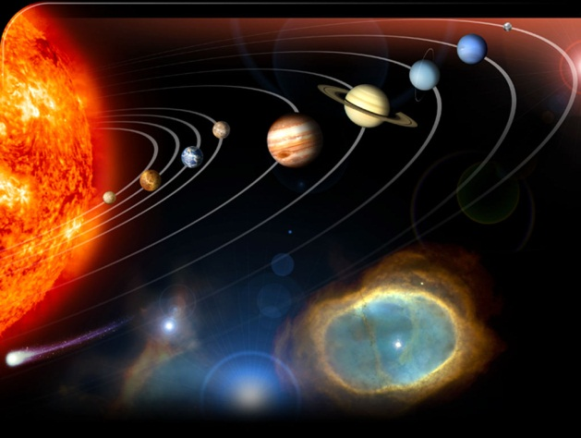

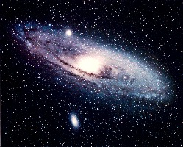


Astronomy and the Bible
Mike Riddle

Slide 2


Is the big bang compatible with the Bible?

Slide 3


Science and the Bible
Science
Evolution

Slide 4
What Is the Big Bang?
The big bang is a secular story about how the universe came into existence.
The big bang presupposes billions of years.
The big bang is a singularity.
A hypothetical point in space-time at which matter is infinitely compressed.
Notes:
“The ‘big bang’ is a story about how the universe came into existence. It proposes that billions of years ago the universe began in a tiny, infinitely hot and dense point called a singularity. This singularity supposedly contained not only all the mass and energy that would become everything we see today, but also ‘space’ itself.”
Jason Lisle (Ph.D. Astrophysics), Answers Book 3, p. 103.
Singularities are zones which defy our current understanding of physics.
The big bang is a secular story of origins. When first proposed, it was an attempt to explain how the universe could have been created without God.

Slide 5
Logic
Bible
Big Bang
Creation in 6 days
Billions of years
Genesis 1:31 – a perfect creation
Creation full of decay and destruction
God created all things. (Gen 1, Isa 45:12, Col 1:16, Jer 32:17, Neh 9:6, John 1:3, Acts 14:15, Eph 3:9, Heb 11:3, Rev 4:11)
God is not the Creator of all things

Slide 6
Bible
Big Bang
Earth, stars
Stars, earth
Birds, reptiles
Reptiles, birds
Water
Molten mass
Land plants, sun
Sun, land plants
Man before death
Death before man

Slide 7
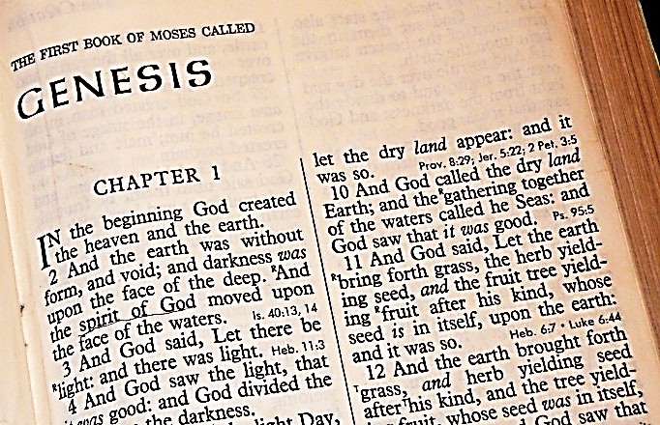


Genesis the Big Bang and the Gospel
No foundation for the Gospel

Slide 8



Gospel = “Good News”
For God sent not his Son into the world to condemn the world; but that the world through him might be saved.
John 3:17
What is

Slide 9
The Gospel
Christ
God’s solution - Jesus Christ
How He acted to save us
The central/core of the Gospel

Slide 10

1 Corinthians 15:3-4
(The Core/Power of the Gospel)
For I delivered unto you first of all that which I also received, how that Christ died for our sins according to the scriptures;
And that he was buried, and that he rose again the third day according to the scriptures:

Slide 11
Acts 17
Paul in Athens
Luke 24
Jesus on the road to Emmaus
God
Christ
God’s creation was perfect
He sets the rules
We are accountable to Him
Why we call Him Lord

Slide 12
How do I come to be included in Salvation?
God
Man
Christ
The Fall – sin (separation from God)
The problem – man disobeyed God
Why we die
Why we need a Savior

Slide 13
God
The Gospel
Man
Christ
Response
For by grace are ye saved through faith; and that not of yourselves: it is the gift of God:
Not of works, lest any man should boast.
Ephesians 2:8-9

Slide 14
A Different Foundation
Big Bang
A False Gospel
Christ
Response
Why did Jesus have to go to the Cross?
Notes:
I marvel that ye are so soon removed from him that called you into the grace of Christ unto another gospel:
Ga 1:7 Which is not another; but there be some that trouble you, and would pervert the gospel of Christ.

Slide 15
Galatians 1:6-7
I marvel that ye are so soon removed from him that called you into the grace of Christ unto another gospel:
Which is not another; but there be some that trouble you, and would pervert the gospel of Christ.
Notes:
I marvel that ye are so soon removed from him that called you into the grace of Christ unto another gospel:
Ga 1:7 Which is not another; but there be some that trouble you, and would pervert the gospel of Christ.

Slide 16

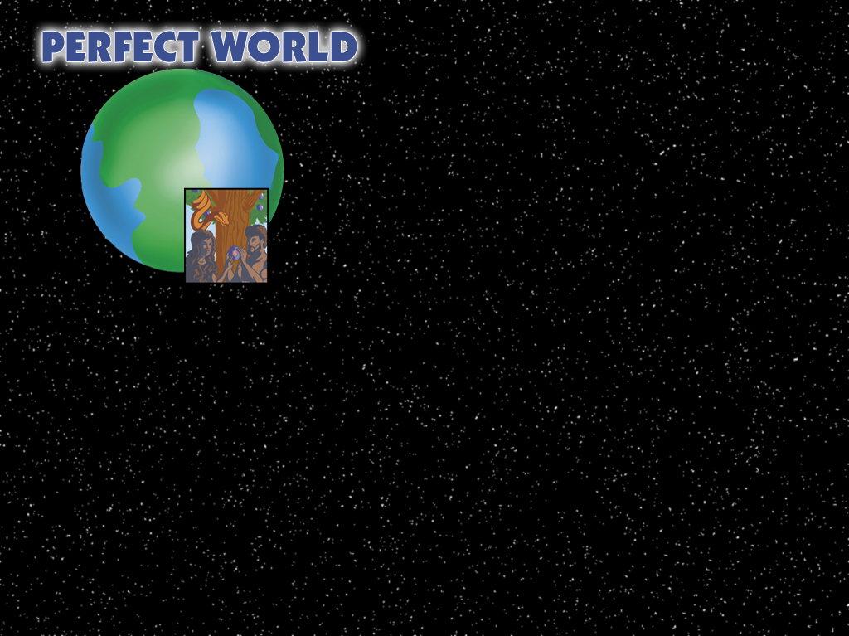


Perfect Creation
Restoration
God’s plan of redemption
Death
Disease
Pain
Suffering
SIN
Notes:
God’s plan of redemption is based on what happened in Genesis. Genesis is key to understanding the Bible!

Slide 17
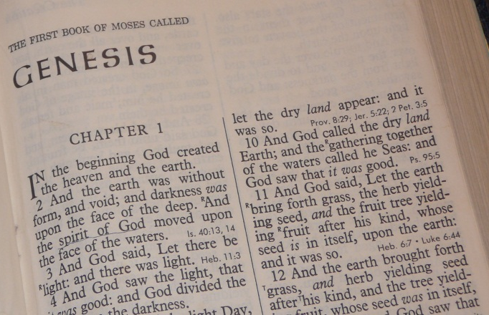
Perfect Creation
Restoration
The foundation for understanding the Gospel starts in Genesis
God’s plan of redemption
Death
Disease
Pain
Suffering
SIN
Notes:
God’s plan of redemption is based on what happened in Genesis. Genesis is key to understanding the Bible!

Slide 18
Conclusion
The big bang undermines the foundation for the Gospel.
The big bang presupposes death before sin.
The big bang makes God the author of death and decay
The big bang is not logically compatible with the Bible.
The big bang has many scientific problems.

Slide 19
Scientific Evidence and the Big Bang
Fact, Theory, or Speculation
7
Problems

Slide 20
The Origin of Stars
Earth Science: Geology, the Environment, and the Universe, Glencoe and McGraw-Hill, 2002, p. 822.
“All stars form in much the same manner as the Sun did. The formation of a star begins with a cloud of interstellar gas and dust, called a nebula, which collapses on itself as a result of its own gravity…. The condensed object will become a new star.”

Slide 21
The Origin of Stars
And God made two great lights; the greater light to rule the day, and the lesser light to rule the night: he made the stars also.
Genesis 1:16

Slide 22
Star Formation and Physics
The popular idea is that stars form from vast clouds of gas and dust through gravitational contraction.
Gas and dust clouds will expand NOT contract
Nebula

Slide 23
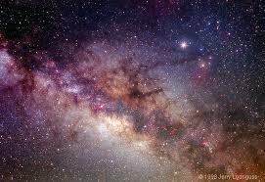
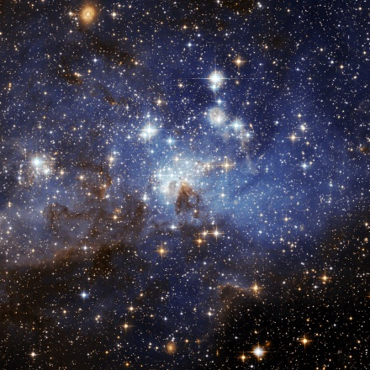
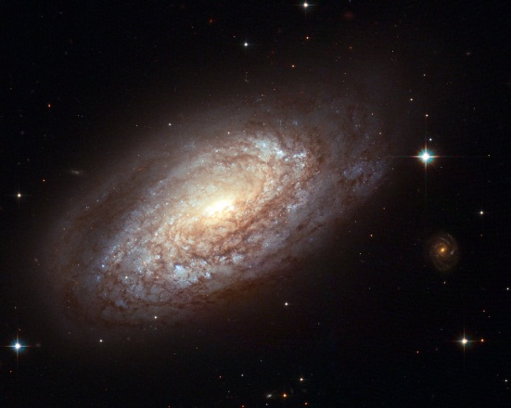
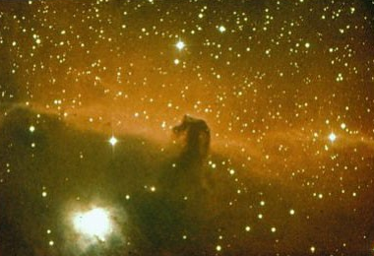
Don DeYoung (Ph.D. in Physics), Astronomy and the Bible, 2000, p. 84.
“The complete birth of a star has never been observed.”

Slide 24
Fred Whipple, The Mystery of Comets, (Washington, D.C.: Smithsonian Institute Press, 1985), pp. 211, 213.
“Precisely how a section of an interstellar cloud collapses gravitationally into a star … is still a challenging theoretical problem… Astronomers have yet to find an interstellar cloud in the actual process of collapse.”

Slide 25
Jason Lisle (Ph.D. Astrophysics), The New Answers Book 3, 2009, p 193.
“It [star formation] has never been observed, nor could it truly be observed since the process is supposed to take hundreds of thousands of years.
Gas in space is very resistant to being compressed into a star. Compression of gas causes an increase in magnetic field strength, gas pressure, and angular momentum,…”

Slide 26
Charles Lada and Frank Shu (both astronomers), “The Formation of Sunlike Stars,” Science, 1990, p. 572.
“Despite numerous efforts, we have yet to directly observe the process of stellar formation…. The origin of stars represents one of the fundamental unsolved problems of contemporary astrophysics.”

Slide 27
John Hartnett (Ph.D. Physics), Dismantling the Big Bang, 2005, p. 144.
“Without ‘something else’ the outward pressure due to kinetic energy of the gas molecules in the cloud is so much greater than the inward pressure due to the mutual gravitational attraction of the cloud that the resulting net outward pressure would cause the gas cloud to disperse rather than collapse.”

Slide 28
Star Formation and Time
100 billion galaxies (10¹¹)
200 billion stars per galaxy (2x10¹¹)
Universe 20 billion years old (2x10¹⁰)
Stars
100 Billion x 200 Billion
20,000,000,000,000,000,000,000
Notes:
If we do per galaxy we divide 200 bil by 20 bil years and get 10 stars per year for 20 billion years. Evolutionists will not have a problem with this. This uses the galaxy as our volume instead of the universe.
If we use 13.7 billion years it comes out to 15 stars per year per galaxy. However this all assumes all galaxies formed at the same time 13.7 billion years ago.

Slide 29

20,000,000,000,000,000,000,000
20 Billion Years
31,700 stars per second
Notes:
This is an average per second.

Slide 30
Conclusion on Star Formation
Abraham Loeb, (Harvard Center for Astrophysics), quoted by Marcus Chown, “Let there be Light”, New Scientist, Feb 7, 1998.
“The truth is that we don’t understand star formation at a fundamental level.”
Notes:
Why is it then that many textbooks state they know how stars form? Are all these scientists wrong in stating we don’t know?
Perhaps we are seeing such a strong belief in a system called evolution, that evidence does not matter – all that matters is that we believe in evolution.

Slide 31
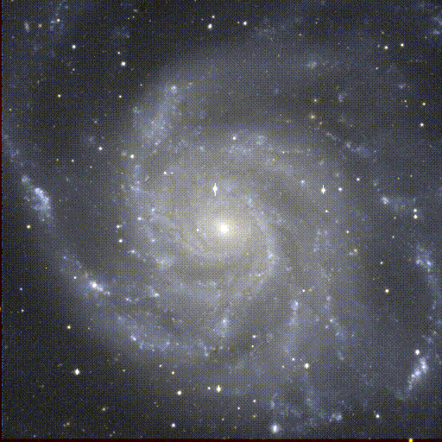
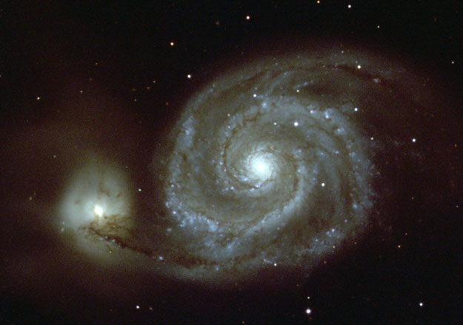
Problem #2
Spiral Galaxies
Spiral Galaxy M101
M51 The Whirlpool Galaxy
Notes:
Spirals like our galaxy are formed by differential rotation. The farther from the center, the slower the rotation.
The very distant galaxies should not have had time to develop spirals, yet they are there. They are too young. Also after a few rotations the spiral arms should be gone. Each rotation is about several hundred million years.
“The stars of our own galaxy, the Milky Way, rotate about the galactic center with different speeds, the inner ones rotating faster than the outer ones. The observed rotation speeds are so fast that if our galaxy were more than a few hundred million years old, it would be a featureless disc of stars instead of its present spiral shape.”

Slide 32
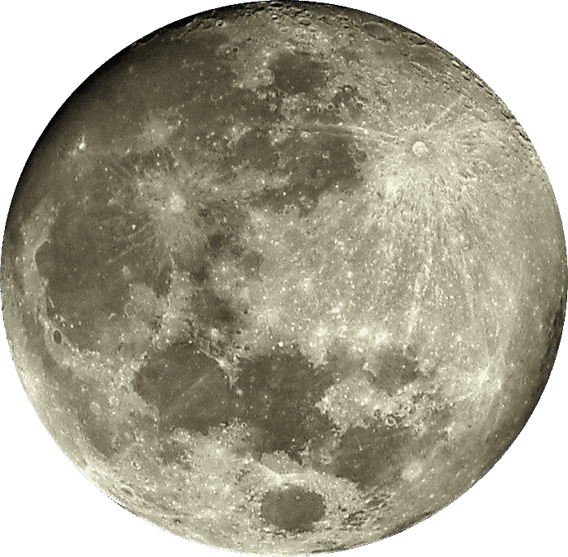
Problem #3
Recession of the Moon

Slide 33

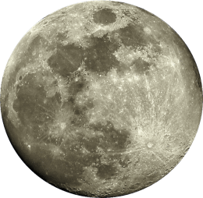
Recession of the Moon
Earth’s force of gravity pulls on the moon
The moon pulls back on the earth (Newton’s 3rd law of motion)
This causes the moon to accelerate in its orbit so that it slowly spirals away from the earth (4 cm/ year)
Notes:
back to about 1 billion years the recession is linear. After 1-billion years it accelerates using the equation 1/R⁶
The separation rate is strongly dependent on the total earth-moon distance.
dr/dt = k/r⁶ where k is a constant and r is the distance.
Roche limit (11,500 miles) Moon could never have been closer – Earth’s tidal forces would have destroyed it (moon)

Slide 34
Earth – Moon Distances
1,000 years ago 125 feet closer
1 million years ago 28.4 miles closer
10 million years ago 284 miles closer
100 million years ago 2,840 miles closer
1 billion years ago 28,400 miles closer
1.5 billion years ago contact
Notes:
Friction by the tides is slowing the earth’s rotation, so the length of a day is increasing by 0.002 seconds per century. This means that the earth is losing angular momentum.7 The Law of Conservation of Angular Momentum says that the angular momentum the earth loses must be gained by the moon. Thus the moon is slowly receding from Earth at about 4 cm (1½ inches) per year, and the rate would have been greater in the past. The moon could never have been closer than 18,400 km (11,500 miles), known as the Roche Limit, because Earth’s tidal forces (i.e., the result of different gravitational forces on different parts of the moon) would have shattered it. But even if the moon had started receding from being in contact with the earth, it would have taken only 1.37 billion years to reach its present distance.8 NB: this is the maximum possible age — far too young for evolution (and much younger than the radiometric ‘dates’ assigned to moon rocks) — not the actual age.
The earth’s gravity keeps the moon in orbit . The moon exerts the same force on the earth. But the force is somewhat higher on the part of the earth nearest the moon, so any water there will bulge towards it — a high tide

Slide 35
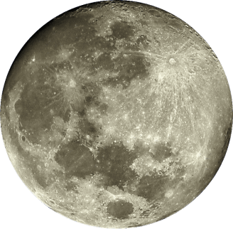

Recession of the Moon
Distance from Earth
Contact
1.5 bya
1.0 bya
today
Time
Notes:
The separation rate dr/dt, is strongly dependent on the total earth-moon distance r.

Slide 36
Problem #4
Scientists

Slide 37
Danny Faulkner Ph.D. Astronomy
John Byl Ph.D. Astronomy
Tom Greene Ph.D. Astronomy
Dave Harrison Ph.D. Astrophysics
James Dire Ph.D. Astrophysics
Jason Lisle Ph.D. Astrophysics
John Rankin Ph.D. Mathematical Physics
Keith Wanser Ph.D. Condensed Matter Physics
Russell Humphreys Ph.D. Physics
Barbara Helmkamp Ph.D. Physics
Don DeYoung Ph.D. Physics
Robert Gentry Ph.D. Physics
Eugene Chaffin Ph.D. Nuclear Physics
Ron Samec Ph.D. Physics
John Cimbala Ph.D. Aeronautics
Andrew McIntosh Ph.D. Combustion Theory
Hee-Choon No Ph.D. Nuclear Engineering
Jay Wile Ph.D. Nuclear Chemistry

Slide 38
An open letter to the scientific community by 405 scientists, May 2004
New Scientist, www.cosmologystatement.org
An open exchange of ideas is not tolerated
The big bang today relies on a growing number of hypothetical entities, things we have never observed

Slide 39
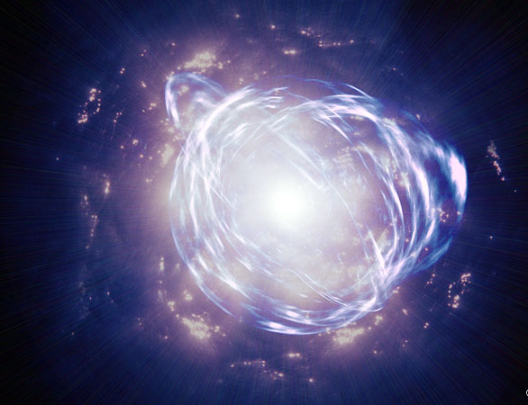
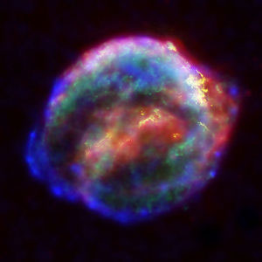
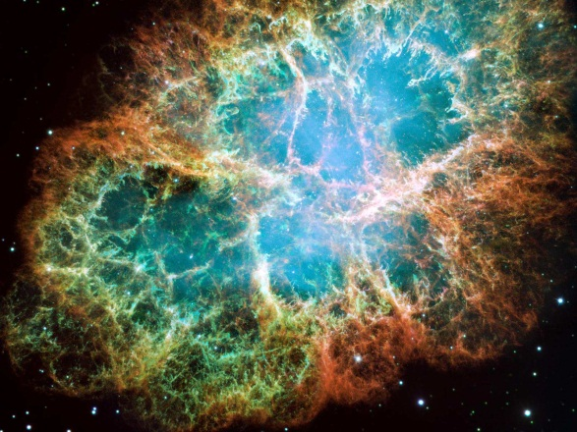
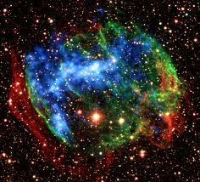
Problem #5
Supernova Remnants

Slide 40
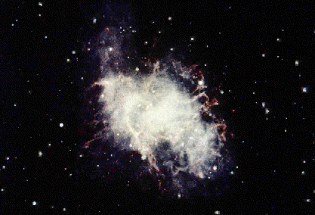
Evidences for a Young Universe
Supernova remnants (SNRs)
Crab Nebula
Light from the supernova reached the earth in 1054
Notes:
Star cores fuse helium into carbon, then oxygen, and continue upward to the element iron. However iron atoms will not undergo fusion to heavier elements. With the nuclear energy process extinguished, gravity then causes the star to collapse upon itself. This sudden contraction heats the star and triggers a destructive explosion.
Crab Nebula was observed by Chinese astronomers in 1054. The star explosion was as bright as Venus in the night sky. It could be seen for several months. One of the last supernovas was recorded by astronomers Kepler and Galileo in 1604.
In 1987 a more distant supernova made headlines when it was observed in the Magellanic Cloud, a neighboring galaxy about 180,000 light years away.

Slide 41
Evidences for a Young Universe
Supernova remnant
Number of observable SNRs predicted if our galaxy is:
Actual number observed
Stage
Billions of years old
6000 years old
First
2
2
5
Second
2260
125
200
Third
5000
0
0
Notes:
All the observed supernova remnants appear to be less than 10,000 years old.
This is controversial because the data is 2 decades old
There should be a super nova occurring about every 25 years. So for stage 1 we should observe about 12 (astronomers calculate that only about 19% of super novas should be visible)
First stage 300 years. Based on blast wave form. It emits lots of energy and lasts for about 300 years
Second stage involves a powerful emitting of radio waves. Last for about 120,000 years
The third stage emits little energy and lasts for 1 to 1.6 million years.

Slide 42
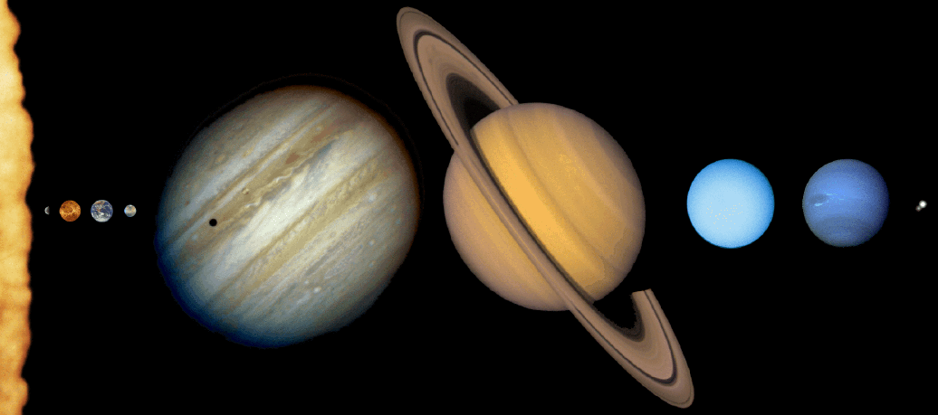
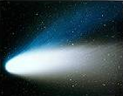
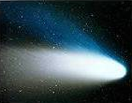
Problem #6 Comets
Short-period comets
Long-period comets
Notes:
Comets should be gone through either escape, collision or disintegration.
More then 100 icy objects have been observed beyond Neptune

Slide 43
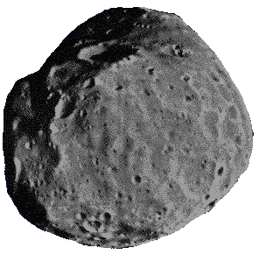
Kuiper Belt
KBO
6 miles
60 – 300 miles
Notes:
About 600 KBOs have been discovered as of 2002. However, these objects are about 100 to 500 kms in diameter. This is too large for a comet. The diameter of the nucleus of a typical comet is 10kms. If we were to see a comet 100kms in size it would make a very impressive sight. We see none of these.
The largest comet nucleus ever observed was that of Comet Hale-Bopp in 1997 with a diameter estimated to be about 40 km (25 miles). All of the Kuiper belt objects allegedly discovered are far bigger than this.

Slide 44
More Problems with the Big Bang
Missing Monopoles
The Flatness Problem
Missing Population III Stars
Where is the Antimatter?
Jason Lisle, Ph.D. Astrophysics

Slide 45
Problem #7
The Bible
In the beginning God created

Slide 46
17 times the Bible declares that God stretched the heavens
2 Sam 22:10 Job 37:18 Isaiah 51:13
Psalm 18:9 Isaiah 40:22 Jeremiah 10:12
Psalm 104:2 Isaiah 42:5 Jeremiah 51:15
Psalm 144:5 Isaiah 44:24 Ezekiel 1:22
Job 9:8 Isaiah 45:12 Zechariah 12:1
Job 26:7 Isaiah 48:13

Slide 47
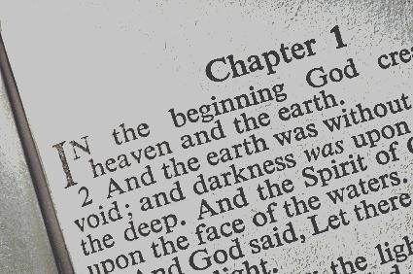
The entire Bible begins with the words, “In the beginning God created the heaven and the earth.”
The Bible nowhere mentions the Big Bang or billions of years.
Notes:
If God is capable of supernaturally creating everything, is He not also capable of supernaturally communicating and preserving His Word without error?

Slide 48
The Authority of Scripture
2 Timothy 3:16-17
All scripture is given by inspiration of God, and is profitable for doctrine, for reproof, for correction, for instruction in righteousness:
That the man of God may be perfect, throughly furnished unto all good works.
The word “inspiration” (Greek theopneustos) literally means “God-breathed”
Notes:
http://www.cbn.com/cbnnews/460652.aspx
Erick Stakelbeck
Friday, January 09, 2009

Slide 49
The Authority of Scripture
2 Peter 1:21
For the prophecy came not in old time by the will of man: but holy men of God spake as they were moved by the Holy Ghost.
Notes:
http://www.cbn.com/cbnnews/460652.aspx
Erick Stakelbeck
Friday, January 09, 2009

Slide 50
The Authority of Scripture
Colossians 1:16
For by him were all things created, that are in heaven, and that are in earth, visible and invisible, whether they be thrones, or dominions, or principalities, or powers: all things were created by him, and for him:
Notes:
http://www.cbn.com/cbnnews/460652.aspx
Erick Stakelbeck
Friday, January 09, 2009

Slide 51
Question
These Scriptures beg the question:
Does God breathe error?
Notes:
A god who breathes error is not worthy of our respect and worship. A god who breathes and communicates error has been created in our own sinful and finite image.

Slide 52
Jeremiah 32:17
Ah Lord God! Behold, thou hast made the heaven and the earth by thy great power and stretched out arm, and there is nothing too hard for thee:
Do we believe this?

Slide 53
Critical Thinking Question and Evolution
Show me any observational evidence for evolution that does not require me to use faith?

Slide 54
Two Contrasting Statements
Hebrews 11:3
Through faith we understand that the worlds were framed by the word of God, so that things which are seen were not made of things which do appear.
Through faith we understand that the universe created itself. By faith we understand stars and galaxies formed. By faith we understand planets and all life formed.
Notes:
What does each faith have to offer?

Slide 57
The Bible is consistent with what we observe in the universe

Slide 58
Words have meaning
Jay Pasachoff, Ph.D., Astronomy & Alex Filippenko, Ph.D., Astronomy, The Cosmos: Astronomy in the New Millennium, 2001, p. 375.
“What produced the energy before inflation? This is perhaps the ultimate question. It may have come out of nothing! The meaning of ‘nothing’ is somewhat ambiguous here.”

Slide 59
Wayne R. Spencer, ”Star formation and Creation”, http://www.answersingenesis.org/articles/aid/v3/n1/star-formation-and-creation , November 19, 2008
“Realize that no one saw these stars form. Instead, the properties of these stars, along with their location near gas and dust clouds where astronomers think that stars form is the basis for the belief that they are recently formed stars.”
Notes:
http://www.answersingenesis.org/articles/aid/v3/n1/star-formation-and-creation

Slide 60
God Breathed
The Bible uses the word “day”
Day with a number
Evening and morning
Exodus 20:11 (4th Commandment)
Mark 10:6 (words of Jesus)
Genesis 1:31 (“very good”) and the character of God

Slide 61
Leon Lederman (Nobel Prize Physics) and David Schramm (Ph.D. Physics), From Quarks to the Cosmos, 1995, p. 163.
“In the laboratory, whenever we produce a particle out of pure energy, we also produce its antiparticle…. Our local system is made of matter. The question that then tormented the astronomers was: Where is the antimatter?”

Slide 62
Science vs. Evolution
The origin of matter
The origin of stars

Slide 63
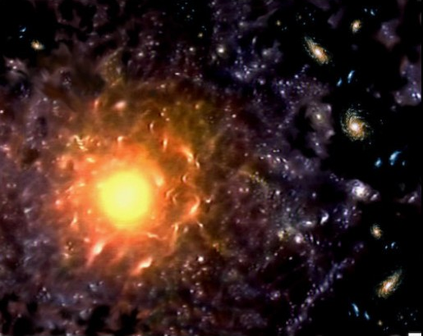
Where did the original matter come from to create the universe?

Slide 64
A Lesson in Science and Logic
The Universe created itself
The Universe has always existed
The Universe was created

Slide 65



ex nihilo nihil fit
“from nothing, nothing comes”
Created Everything
NOTHING

Slide 66
Three Possibilities
The Universe created itself
The Universe has always existed
The Universe was created

Slide 67
Second Law of Thermodynamics
No Refills

Slide 68

No Refills
Finite amount of energy (gas)
After about 300 miles the car is out of fuel (energy) and can no longer move

Slide 69
Stars and Energy
Finite amount of energy (hydrogen)
Thermonuclear fusion
Lighter to heaver elements
H He C O Fe
Notes:
The Second Law states that the quantity of available energy is decreasing.
Therefore, as we go backward in time, the available energy is progressively greater

Slide 70
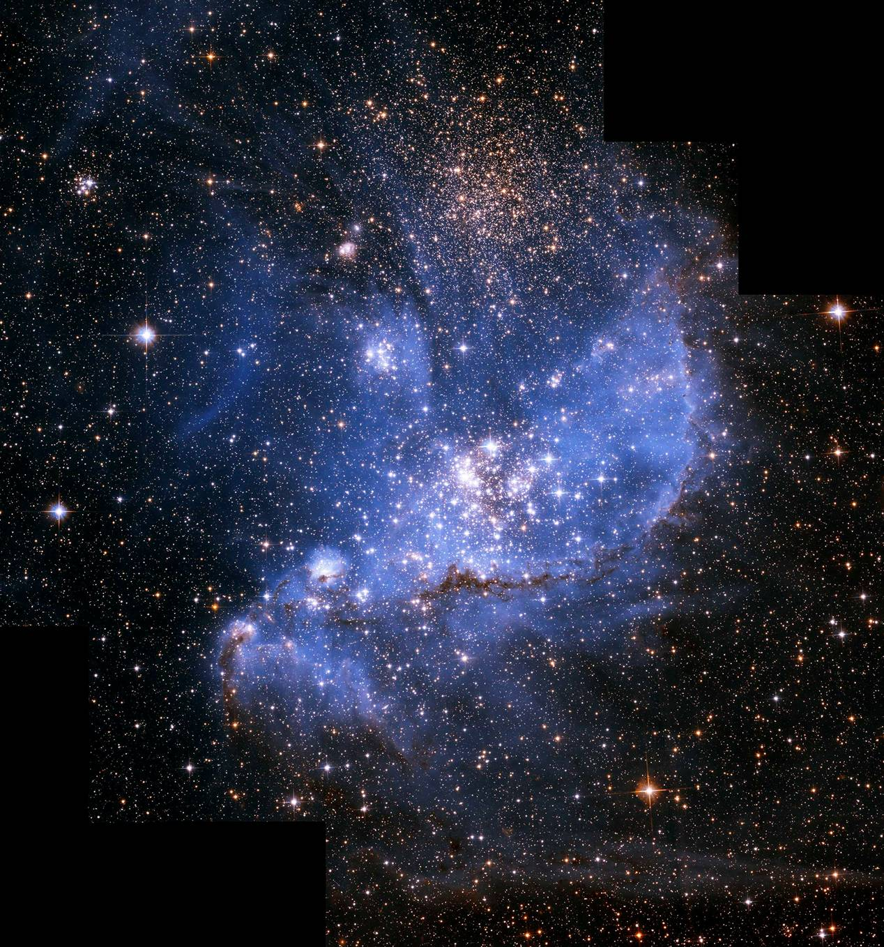
No Refills
Universe
Finite amount of energy
If the Universe had no beginning, then it would be an infinite number of years old (this is older than trillions of years)
Notes:
13.7 billion years old indicates a beginning
13.7 billion years ago the universe had more energy
If the universe is infinite in age, it would have had an infinite amount of time to cool down, and would therefore be near absolute 0 Kelvin
so the universe has not had an infinite amount of time to cool down, so is finite in age.

Slide 71
Time without end
Latin for boundless (without end)
Unlimited extent of time
Infinity
Notes:
Infinity means no amount of time can
“The most massive of new stars, the supergiants, burn so furiously that they exhaust their fuel and detonate as supernovae within only about 10 million to 100 million years…”
Timothy Ferris, The Whole Shebang, 1997, p. 186.
Violates four principles/laws: proponents of the big bang (had a beginning), 2nd law, mathematics, perpetual motion (physics)
The Universe is eternal- an eternal universe directly contradicts the current view of the scientific evidence which teaches that the universe had a specific beginning (proponents of the Big Bang). It then contradicts the scientific fact that the Universe is gradually running out of available energy. The 2nd law of thermal dynamics which shows everything is winding down (loosing available heat energy) from a beginning which means it has an end. Mathematical calculations show If it was as old as scientists say it would have died from heat loss long ago. To be eternal by its nature means it has a constant energy and everything that it has is already supplied. But something was introduced that began it all, something that was not there before. Where did that something come from that affected the order of the universe.
Scientists and engineers accept the possibility that the current understanding of the laws of physics may be incomplete or incorrect; a perpetual motion device may not be impossible, but overwhelming evidence would be required to justify rewriting the laws of physics.

Slide 72
The Universe is constantly converting useful energy into less usable forms
100 Million
Years
10 Billion
Years
100 Billion
Years
1 Trillion Years
No Stars
Notes:
Small stars burn dimly, but for a very long time; tens of billions of years or more. Giant stars use up all their fuel quickly and explode into supernovas in only a few hundred million years.
A star the size of our Sun will last for about 10 billion years

Slide 73
Conclusion
The Universe cannot be infinite (no beginning) or it would be out of energy
Notes:
One might also hypothesize that it is meaningless to talk about a "before" in time when the universe was compressed into state of total energy because at this point in time, as time and matter are relative to each other, eternity existed in a moment.
While this is true, it doesn't solve the problem of there being a system with all the available energy in the universe being compressed into a single point and space in time.
The scientific conundrum from a purely metaphysical naturalistic point of view is that energy cannot create itself, or come into existence from non-existence by itself.
Something else besides the known universe must exist in order for the known universe to exist.
"In the beginning, God created the heavens and the earth."
The atheist will not accept this conclusion, however.
He instead hypothesizes that either:
1. Some natural law canceling out the Second Law prevailed far back in time.
2. Some natural law canceling out the Second Law prevails far out in space.
3. Some force more powerful that all the energy in the known universe brought our universe into being.
When he makes the first two assumptions, however, he is denying his own metaphysical naturalism, which says that all things can be explained in terms of presently observable laws and processes.
In the third assumption, the atheist is only denying the inevitable, that someone or something created the known universe.
In all three cases, the atheist is really resorting to creationism, but just refuses to acknowledge a personal Creator God.

Slide 74
Three Possibilities
The Universe created itself
The Universe has always existed
The Universe was created
In the beginning God created the heaven and the earth.
Notes:
Occam’s Razor: principle states that the explanation of any phenomenon should make as few assumptions as possible, eliminating, or "shaving off", those that make no difference in the observable predictions

Slide 75
The Origin of Matter
Joseph Silk (Ph.D. Astronomy and Professor of Astronomy at the University of Oxford), The Big Bang, 2001, p. xv.
“It is only fair to say that we still have a theory without a beginning.”

Slide 76
The Origin of Matter
Sten Odenwald, (Ph.D. Astrophysics and Chief Scientist with Raytheon STX Corp at the NASA Goddard Space Flight Center), The Astronomy Café, 1998, p. 120.
“…astronomers have not the slightest evidence for the supposed quantum production of the universe out of a primordial nothingness.”

Slide 77
Tom Van Flandern (Ph.D. Astronomy), http://metaresearch.org/cosmology/
“Our ability to test cosmological theories has vastly improved with modern telescopes covering all wavelengths, some of them in orbit. Despite the widespread acceptance of the big bang theory as a working model for interpreting new findings, not a single important prediction of the theory has yet been confirmed, and substantial evidence has accumulated against it.”
Notes:
Tom Van Flandern (Ph.D. Astronomy), http://metaresearch.org/cosmology/DidTheUniverseHaveABeginning.asp#footnotes

