Slide 1

Mike Riddle
Answers in Genesis

Slide 2
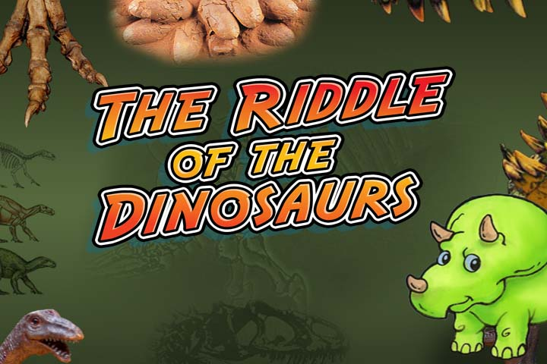
Mike Riddle
Answers in Genesis

Slide 3
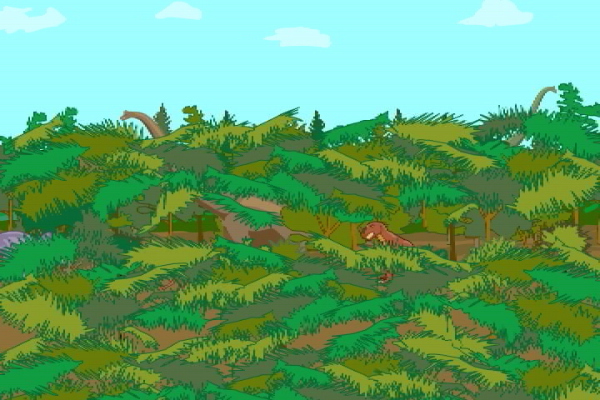

Slide 4
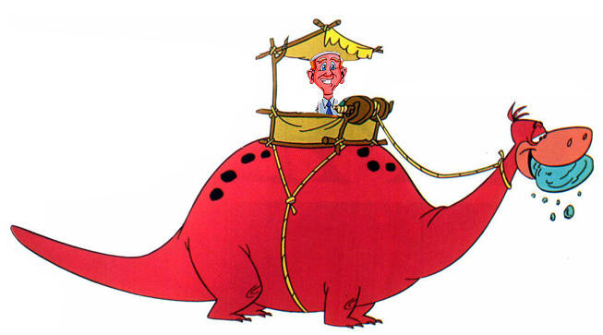
Part 1
Let’s start with understanding dinosaurs

Slide 5
Some Definitions
What is creation?
What is evolution?

Slide 6
The Story of Creation
In the beginning _______ created the heaven and the earth (chance, God).
How long did it take God to create everything (1-day, 6 days, 1-million years)?
God’s creation was (messy, perfect)?

Slide 7
The Days of Creation
In the beginning God created the heaven and the earth.
Day 1
Earth, light, darkness
Day 2
Atmosphere
Day 3
Dry land, seas, plants, fruit, trees
Day 4
Sun, moon, stars
Day 5
Fish, sea creatures, and birds
Day 6
Animals, humans (Adam and Eve)

Slide 8

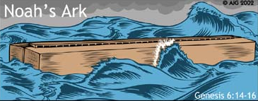

Creation
What did sin do to God’s perfect creation? (nothing, corrupted it)
What was God’s plan to help us? (Hint: John 3:16)
What happened when everyone except Noah and his family became bad?

Slide 9
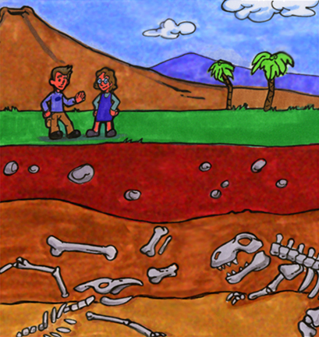
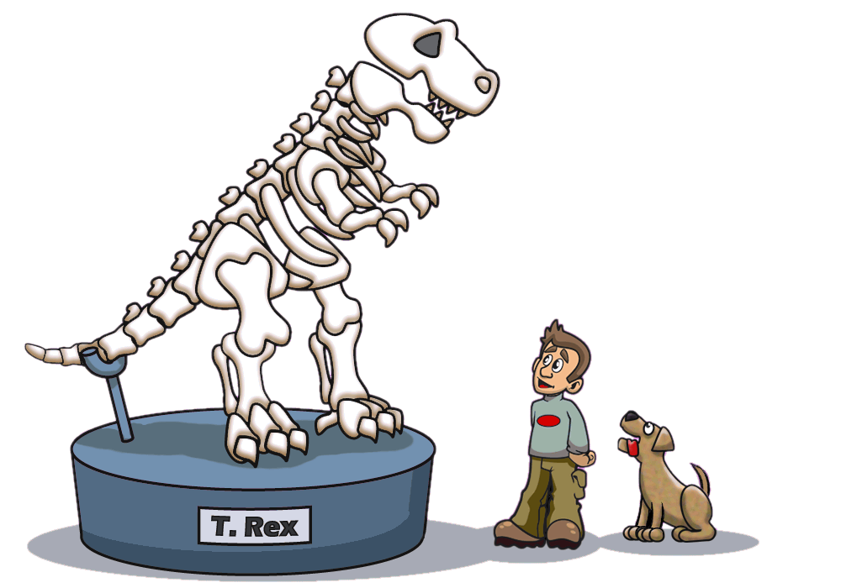
Did Dinosaurs Exist?

Slide 10
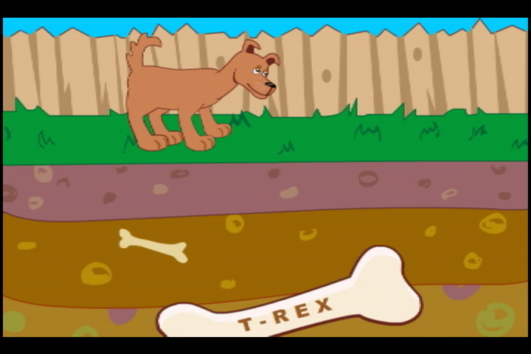

Slide 11
Dinosaur Questions
How many kinds of dinosaurs have been found?
a) About 50 - 100
b) About 700
c) About 5,000

Slide 12

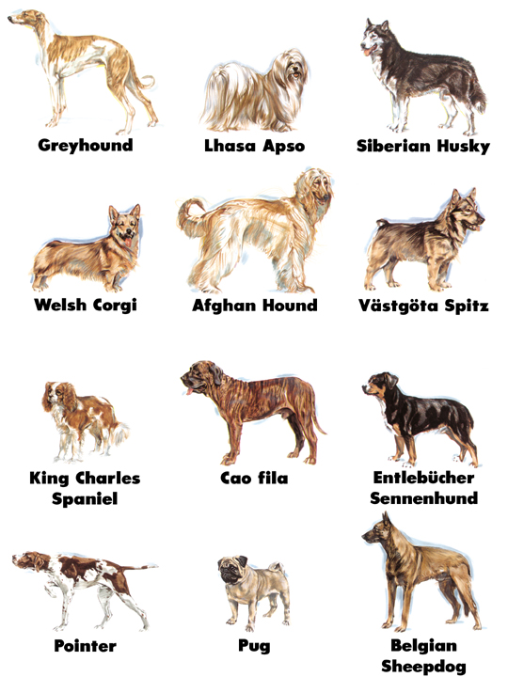

Slide 13
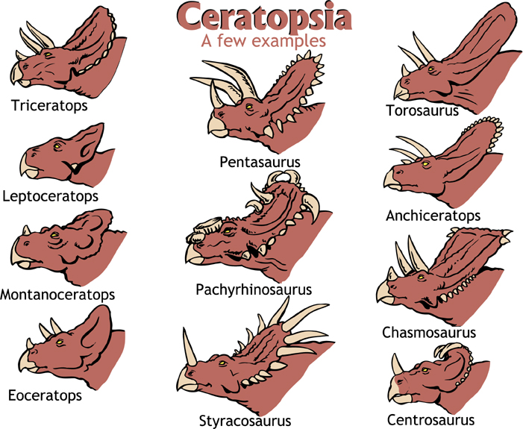
Notes:
Question: Is this many kinds of dinosaurs or just one kind with variety within kind?
Pronounced – sair-uh-TOP-see-as mostly 4-footed plant eaters: characterized by horns and frills

Slide 14
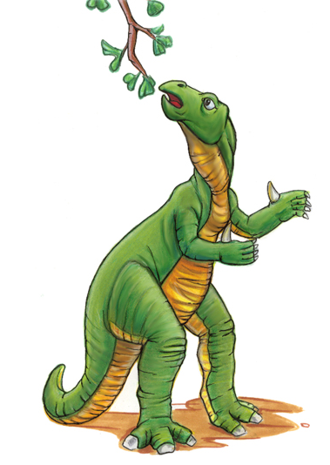
What Did Dinosaurs Look Like?
Iguanodon

Slide 15
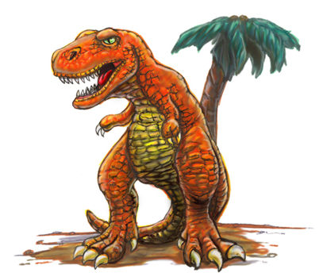
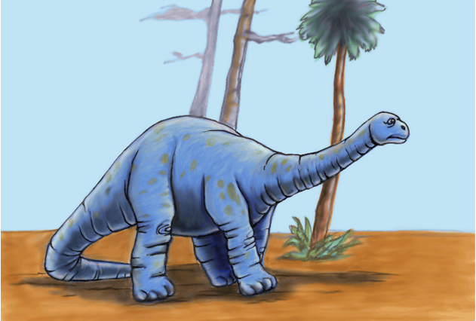
Dinosaur Groups
Theropods
Two-footed meat-eaters (T-rex)
Sauropods
  Four-footed plant- eaters (Apatosaurus)

Slide 16
Long Necks
Ultrasaurus
Supersaurus
Brachiosaurus
Sauropods
Man

Slide 17
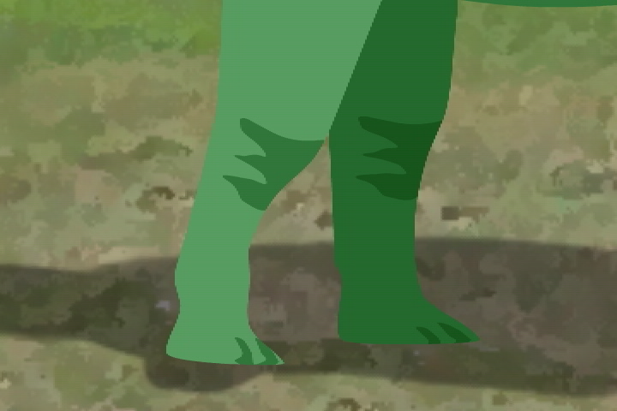

Slide 18
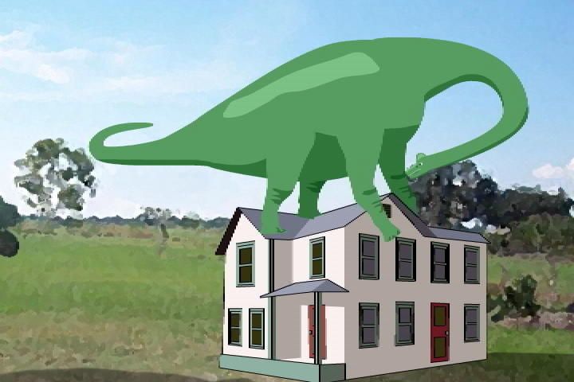

Slide 19

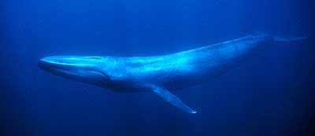
How Big Were Dinosaurs?
The average size was about the size of a small pony
Seismosaurus and Argentinosaurus were over 100 feet long and weighed about 100 tons
Blue whale 200 tons
Supersaurus 100 tons, 130 feet long
Ultrasaurus 100 tons, over 100 feet long
Brachiosaurus 55 tons, 75 feet long
Tyrannosaurus 8 tons, 20 feet tall
African elephant 5 tons

Slide 20
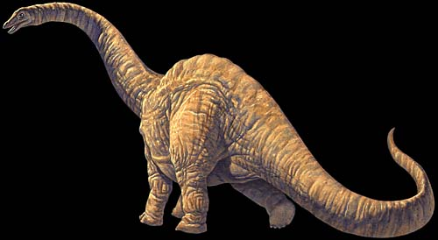


Argentinosaurus
100 tons, 100 feet long

Slide 21
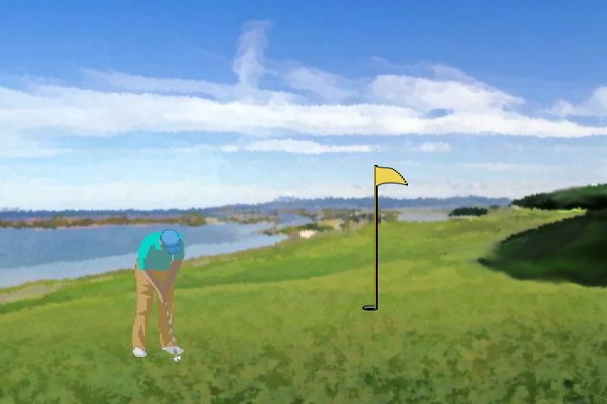

Slide 22
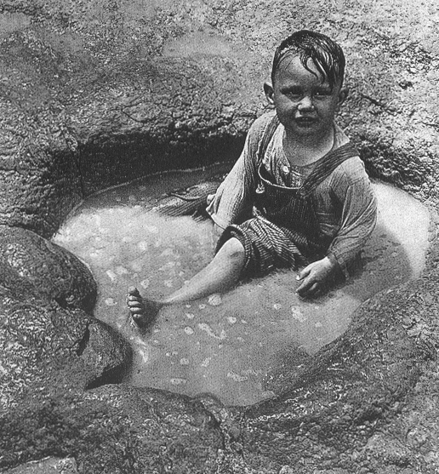
Dinosaur Footprints

Slide 23
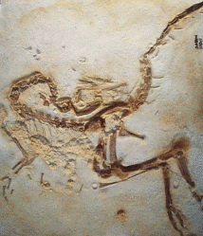
Not All Dinosaurs Were Big
A small dinosaur
Height: 24 inches
Length: 40 inches
Weight: 8 pounds
Compsognathus
Komp-sog-NAY-thus

Slide 24
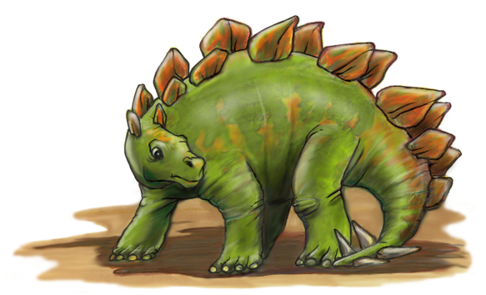
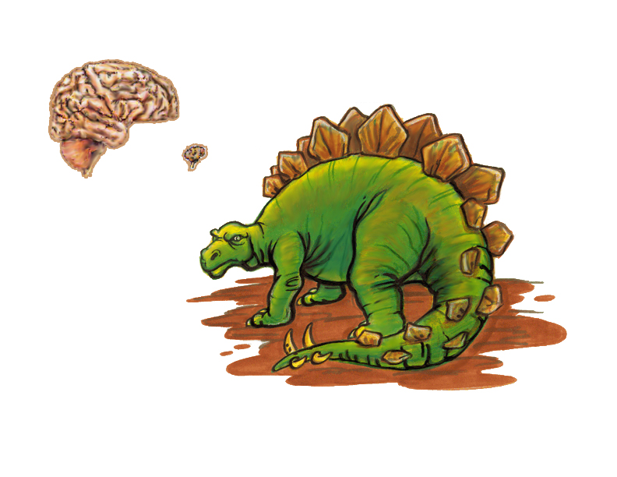
Stegosaurus
Human Brain
Stegosaurus Brain

Slide 25
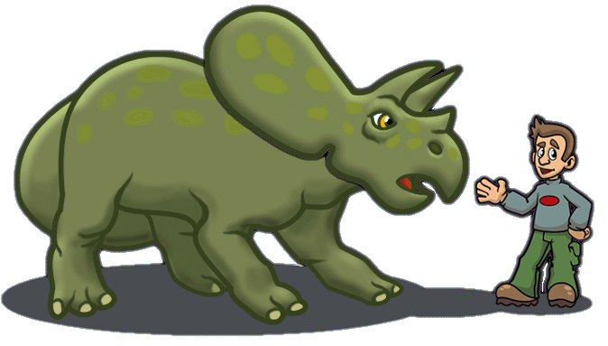
Horned Dinosaurs
Triceratops
Height: 9 feet
Length: 26 feet
Weight: 14,000 pounds (7 tons)

Slide 26
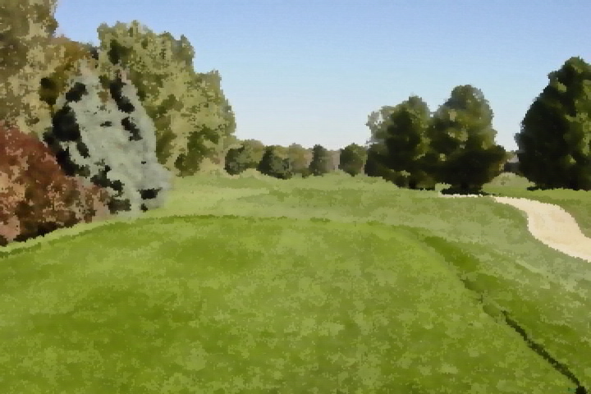

Slide 27
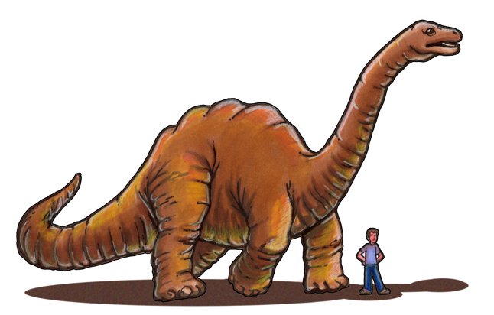
What About Brontosaurus?
Apatosaurus

Slide 28
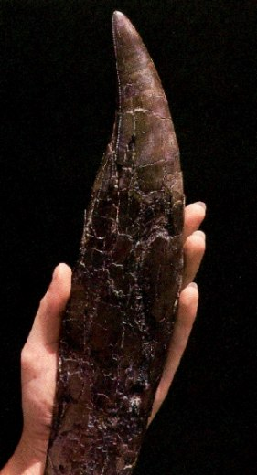
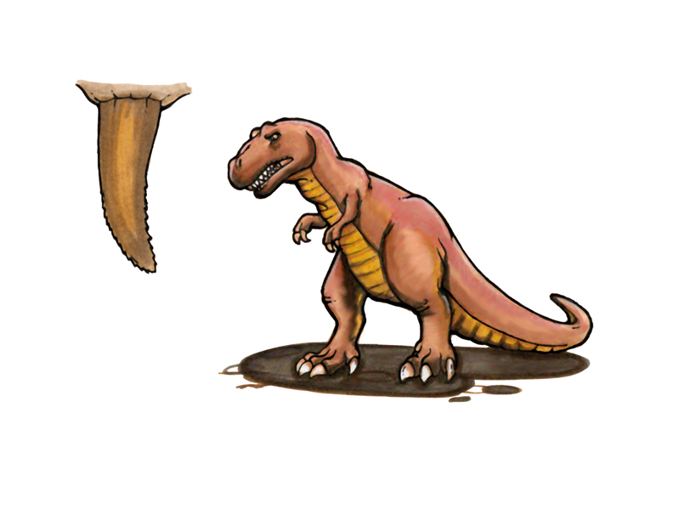
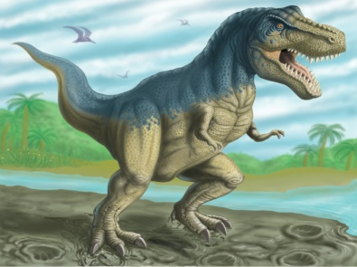
Dinosaurs With Big Teeth
Tyrannosaurus rex

Slide 29
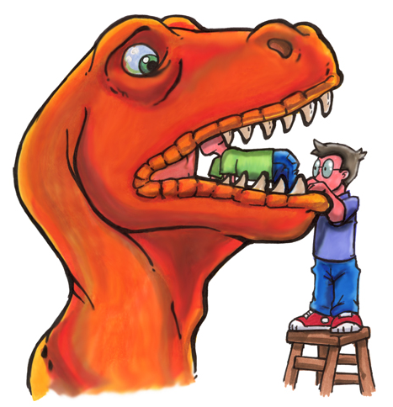
Tyrannosaurus rex

Slide 30
Tyrannous rex and Arms

Slide 31
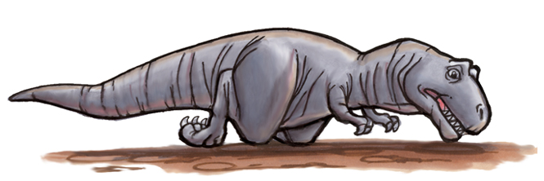
Tyrannosaurus rex
I fell down and I can’t get up

Slide 32
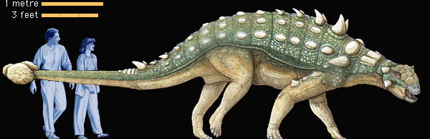
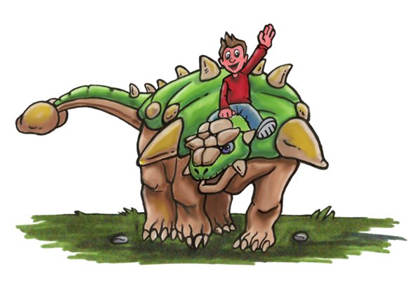
Euoplocephalus
You-op-loh-SEF-ah-lus

Slide 33

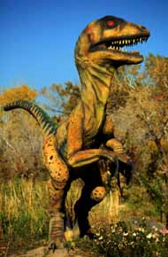
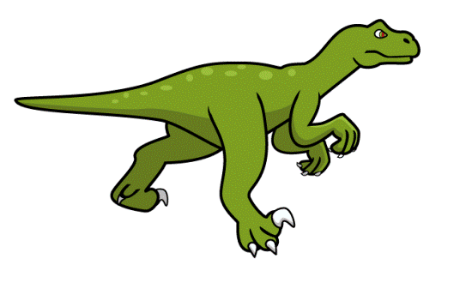
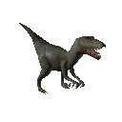
Velociraptor
Velociraptor claw
It had about 80 very sharp, curved teeth
How big was Velociraptor?
3 to 4 feet tall
5 to 6 feet long

Slide 34
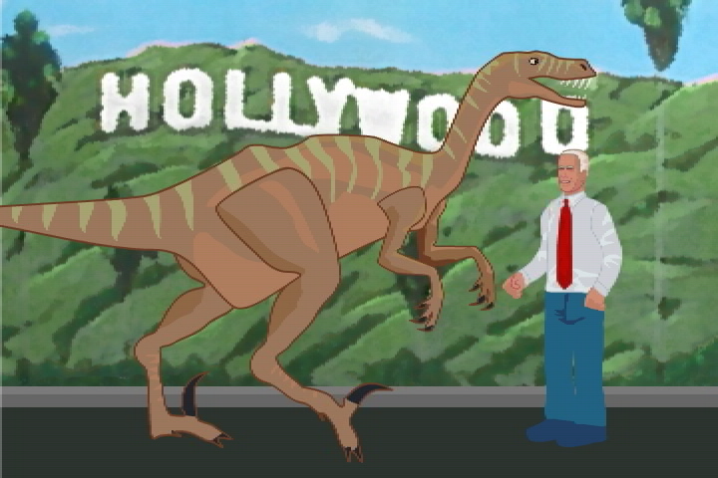

Slide 35
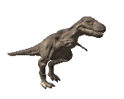

How Fast Were Dinosaurs?
Estimated speeds
Stegosaurs About 15 mph
Tyrannosaurus About 20 mph
Olympic runner About 25 mph
Triceratops About 20 mph
Horse 45 mph
Lion 45 mph
Cheetah 65 mph

Slide 36
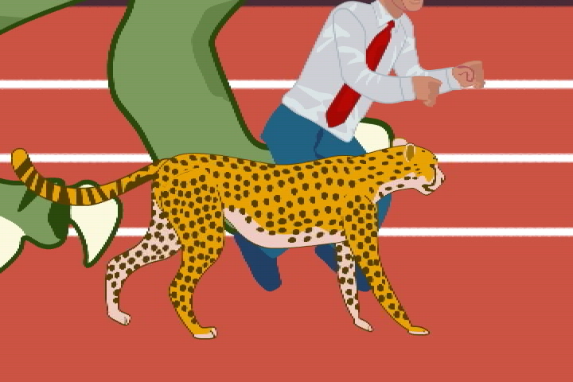

Slide 37
Part 2
Let’s talk about dinosaurs and people

Slide 38
When Did Dinosaurs Live?
And God made the beast of the earth after his kind, and cattle after their kind, and everything that creepth upon the earth after his kind: and God saw that it was good. . . .
And the evening and the morning were the sixth day.
Genesis 1:25 - 31

Slide 39
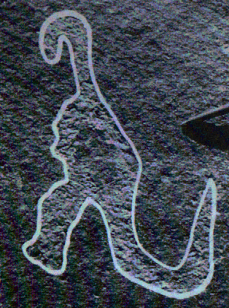
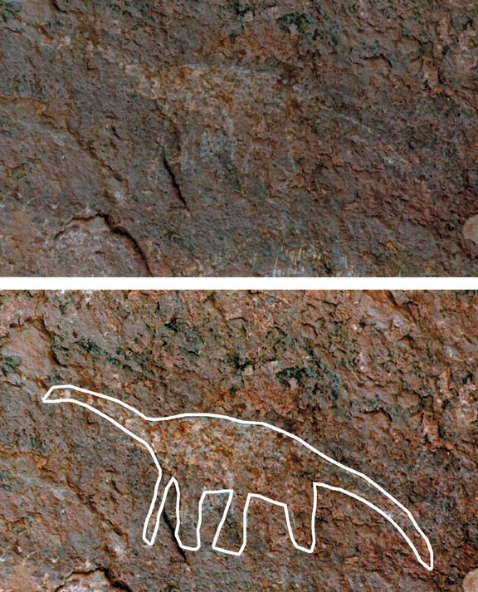
Dinosaurs and People
Many traditions of large dinosaur-like creatures
Ancient drawings (petroglyphs)

Slide 40
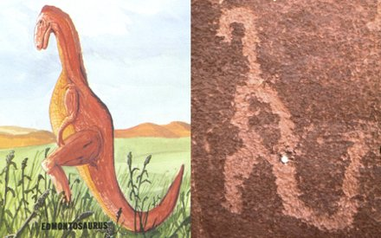
Dinosaurs and People
Petroglyph discovered in Havai Supai Canyon Arizona
Notes:
In the late 1800s, Samuel Hubbard, honorary curator of archaeology at the Oakland, California, Museum of Natural History, was excavating ancient Indian dwellings in the Hava Supai Canyon in Arizona. On the walls of the canyon where the Indians’ ancestors once lived, Dr. Hubbard found elegant drawings of an elephant, an ibex, a dinosaur, and other animals. He stated concerning the dinosaur drawing: “Taken all in all, the proportions are good.” He further suggested that the huge reptile is “depicted in the attitude in which man would be most likely to see it—reared on its hind legs, balancing with the long tail, either feeding or in fighting position, possibly defending itself against a party of men”

Slide 41
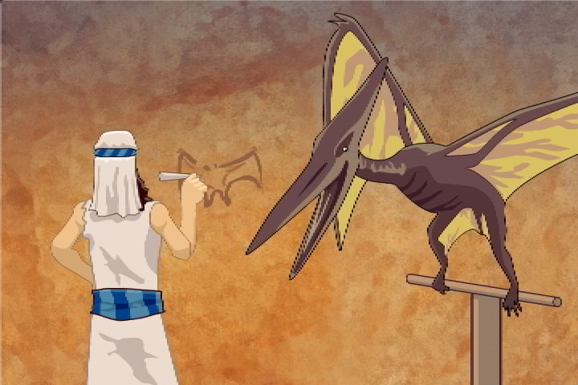

Slide 42
Dinosaurs and People
Dinosaur bones that are not fossilized

Slide 43
New Dinosaur Find
A mummified dinosaur carcass was found in Montana (duck-billed hadrosaur)
Soft tissues covering 90% of the fossil include muscle, nail material, a beak, and skin were preserved
The last meal in its stomach was preserved
A salad of ferns, conifers, and magnolias, seasoned with pollen from 40 different plants
Notes:
Almost a complete specimen of brachylophosaurus, it is said to be the fourth dinosaur ever found in a mummified condition; the other three were found in the early 1900s
This fossil was first discovered in summer 2000, but announced just last weekend at the annual meeting of the Society of Vertebrate Paleontology in Oklahoma. It has been dubbed Leonardo because of nearby graffiti signed by a man named Leonard in 1917.
stomach contents were so well preserved, they could detect Leonardo’s last meal: a salad of ferns, conifers, and magnolias, seasoned with pollen from 40 different plants

Slide 44
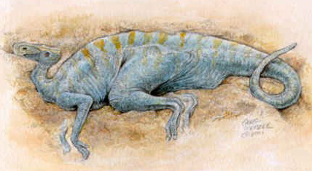
New Dinosaur Find
Artist drawing of what "Leonardo" may have looked like
Notes:
Leonardo was found in sand that hardened to sandstone, both are very porous. Water can move through each which adds to the mystery of how it got mummified. The best scenario is that the dino was buried quickly in sand and chemically-charged sand moved through the pores of the sand. The chemicals rapidly preserved the dino. The water would have to be under high pressure, indicating rapid deposition perhaps hundreds of feet of sediment in a short time. This would cause pressure that would squeeze out the water and lithify the sand and dino.

Slide 45
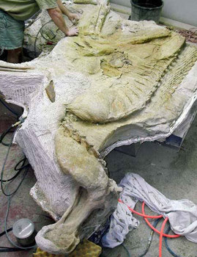
New Dinosaur Find
Photo of "Leonardo"

Slide 46
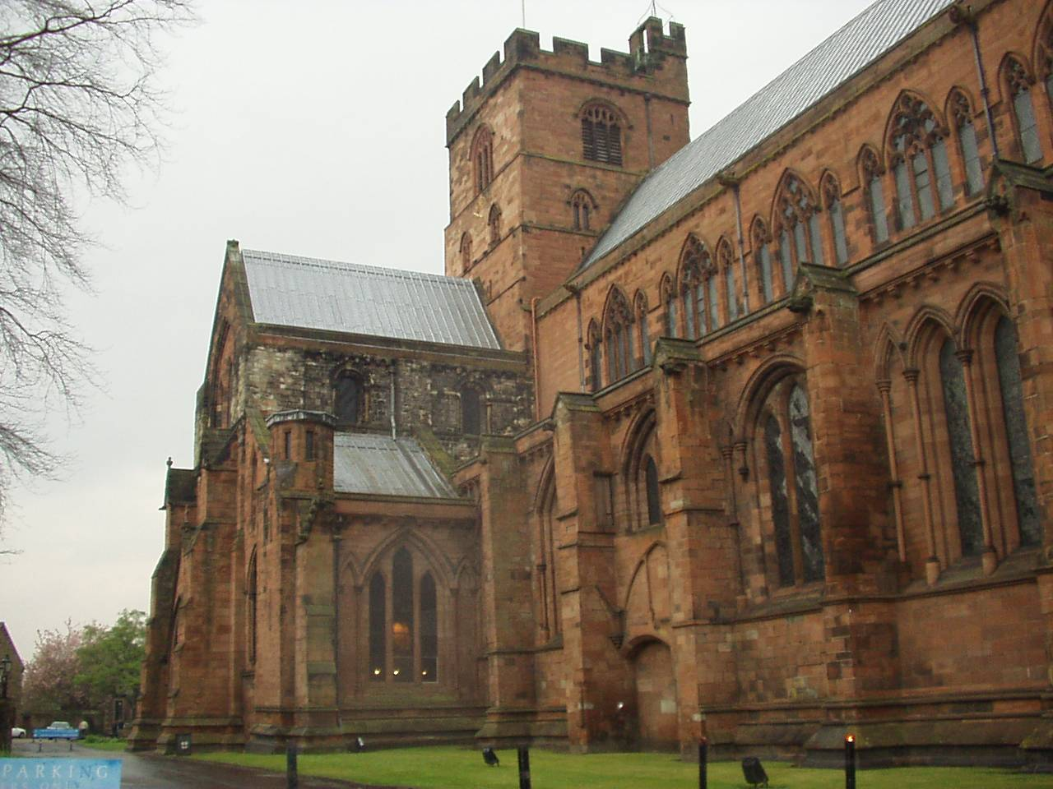
Carlisle Cathedral
Northern England

Slide 47
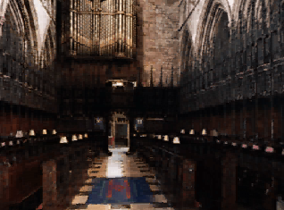
Carlisle Cathedral
Carpet
Tomb of Bishop Richard Bell
Died in 1496

Slide 48
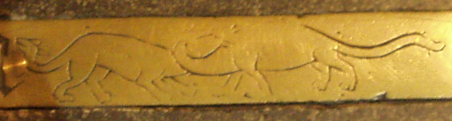
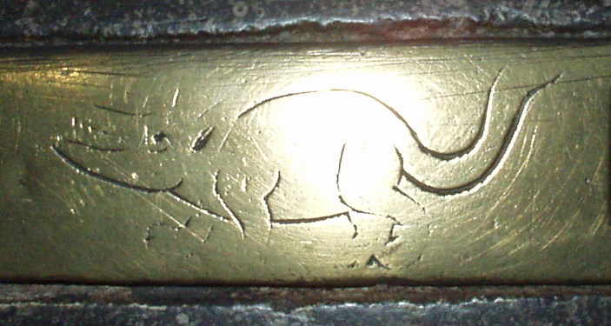
Brass Engravings
Long Neck
Long Tail
Dinosaur Pictures

Slide 49
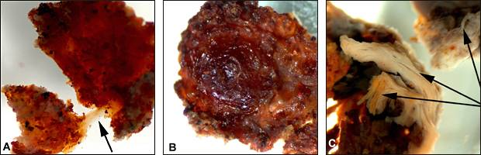
T-rex Soft Tissue
T-rex
elastic tissue
Fresh tissue
Soft fibrous tissue
Red blood cells, fibrous tissue, blood vessels
Notes:
One description of a portion of the tissue was that it is “flexible and resilient and when stretched returns to its original shape”.
The exciting discovery was apparently made when researchers were forced to break open the leg bone of a Tyrannosaurus rex fossil to lift it by helicopter. The bone was still largely hollow and not filled up with minerals as is usual. Dr Schweitzer used chemicals to dissolve the bony matrix, revealing the soft tissue still present

Slide 50
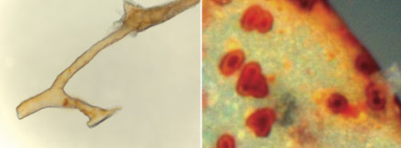
T-rex
Blood vessels
Microscopic structures squeezed out of blood vessels
Notes:
Question: Could the T-rex have died out 65 million years ago? NO!

Slide 51
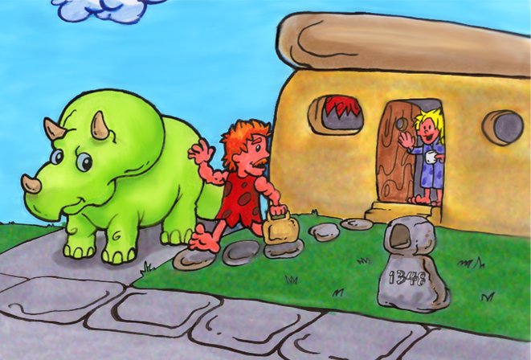
The Pet Dinosaur

Slide 52

What Did Dinosaurs Do?

Slide 53


What Did Dinosaurs Do?

Slide 54


Show and Tell Dinosaur

Slide 55

Part 3
Let’s talk about dinosaurs and the Bible

Slide 56
Are Dinosaurs Mentioned in the Bible?
Job 40:15-18
Behold now behemoth, which I made with thee; he eateth grass as an ox. . . .
He moveth his tail like a cedar . . .
His bones are as strong pieces of brass; his bones are like bars of iron.
He is the chief of the ways of God;

Slide 57







Slide 58



Leviathan
Out of his mouth go burning lamps, and sparks of fire leap out.
Job 41:19

Slide 59


Bombardier Beetle
Chemical storage chamber
Sparks of Fire

Slide 60

Dinosaurs and Dragons

Slide 61
A Question
If dinosaurs are mentioned in the Bible, what happened to them?

Slide 62

What Happened to the Dinosaurs?
Notes:
Picture from AIG web site www.answersingenesis.org

Slide 63


What Happened to the Dinosaurs?
They all starved
They ate too much
Notes:
Pictures from AIG web site www.answersingenesis.org

Slide 64



What Happened to the Dinosaurs?
They changed (evolved) into birds

Slide 65


One more story

Slide 66

People ate the dinosaurs

Slide 67

What Happened to the Dinosaurs?
The Genesis Flood

Slide 68

What Happened to the Dinosaurs?
Did they all die in the
Genesis Flood

Slide 69


Slide 70


Slide 71


Dinosaurs on the Ark
And of every living thing of all flesh, two of every sort shalt thou bring into the ark, to keep them alive with thee; they shall be male and female. (Genesis 6:20)
Dinosaurs were on the Ark and they came off the Ark

Slide 72

Did the Ark look like this?

Slide 73


Slide 74


The Ark was BIG!
450 feet long 75 feet wide 45 feet tall
How could Noah put all the BIG dinosaurs on the Ark?
He took the young dinosaurs

Slide 75

Dinosaurs Survived the Flood

Slide 76

Evidence for Creation

Slide 77

Woodpecker

Slide 78
Life Is Complex
The Human Brain
About 3 pounds
100 trillion connections
Quadrillion bits of information
Quadrillion calculations per second
1 Trillion
1,000,000,000,000

Slide 79


1-Trillion Pennies
18 pennies per inch
876,000 miles
250,000 miles
Notes:
876,823.8 miles

Slide 80
Part 4
How much do you remember?

Slide 81


Question 1
Did dinosaurs become extinct 65 million years ago?
Yes
No

Slide 82
Question 2
Did dinosaurs live at the same time as people?
Yes
No
How do we know?

Slide 83
Question 3
Were dinosaurs on the Ark?
Yes
No

Slide 84

Question 4
What did the Ark look like?
A
B

Slide 85


Question 5
What happened to the dinosaurs?

Slide 86

In the beginning God created

Slide 87
The End
Mike Riddle
www.AnswersinGenesis.org

