Slide 1
The Biblical Basis for Apologetics
Dr. Phil Fernandes
President of
the Institute of Biblical Defense

Slide 2
What is Apologetics?
Apologetics in the defense of the Christian Faith
It involves both defending Christian truth & refuting false beliefs

Slide 3
Different Ways to Defend the Faith
Classical (philosophical)
Evidential (historical)
Presuppoistional (Van Til; Gordon Clark)
Verificational
Comparative Religious
Testimonial

Slide 4
Different Ways to Defend Faith (2)
Cumulative Case
Dialogical
Cultural
Psychological
Scientific
Reformed Epistemology/Basic Belief

Slide 5
Different Ways to Defend Faith (3)
Narrative
Combinational

Slide 6
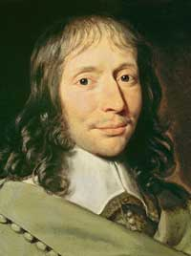
Blaise Pascal—Psychological Apologetics

Slide 7
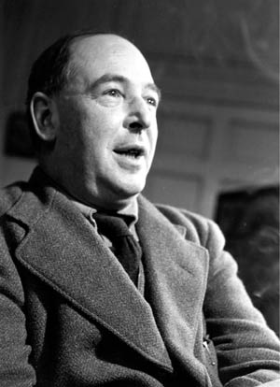
C. S. Lewis—Verificational Apologetics

Slide 8
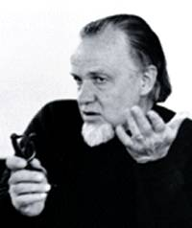
Francis Schaeffer—Verificational Apologetics

Slide 9
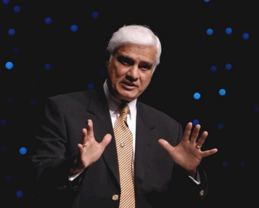
Ravi Zacharias—Classical & Cultural Apologist

Slide 10

William Lane Craig—Classical Apologist

Slide 11
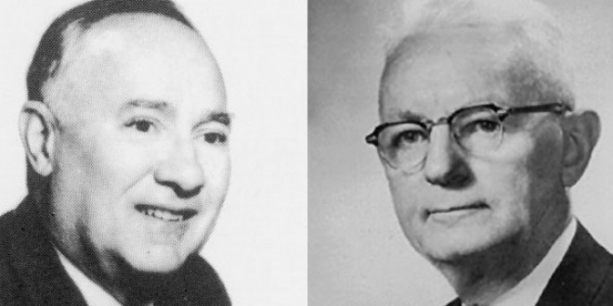
Gordon Clark & Cornelius Van Til—Presuppositional Apologetics

Slide 12
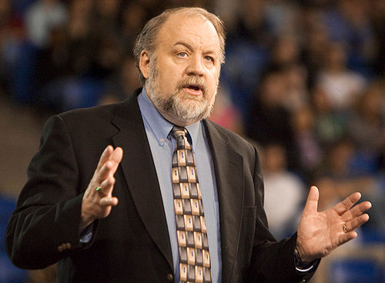
Gary Habermas—Evidential Apologist

Slide 13
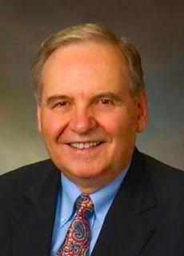
Norman Geisler—Classical Apologist

Slide 14
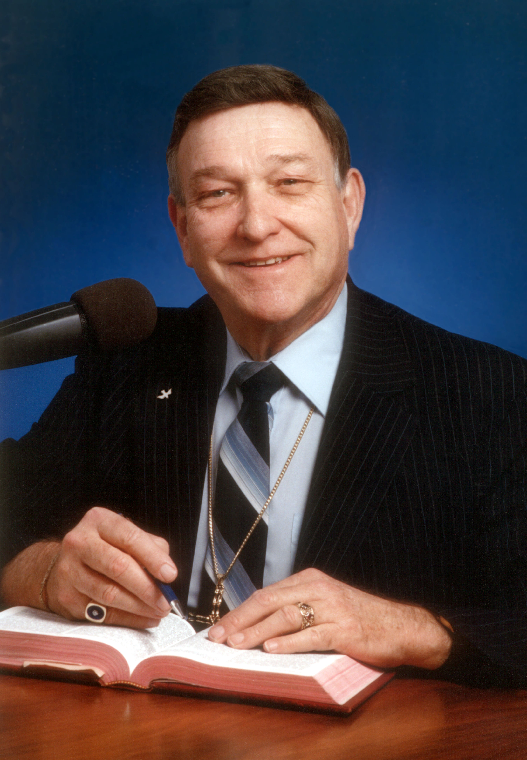
Walter Martin—Comparative Religious Apologist

Slide 15
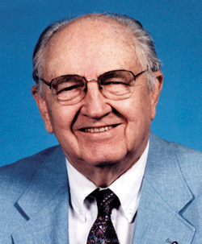
Henry Morris—Scientific Apologist

Slide 16
A Response to Fideism
Fideism is the belief that Christianity should merely be believed & not defended
Faith & Reason do not meet
Soren Kierkegaard (subjective over objective) 1 Corinthians 15:3-8, 14, 17

Slide 17
Biblical Basis for
Traditional Apologetics
#1—The Bible commands us to defend the Faith
1 Peter 3:15
Colossians 4:5-6
Titus 1:7-9
Jude 3

Slide 18
#2 The Bible Speaks of
Natural Revelation
Psalm 14:1; 19:1; 94:9; Romans 1:18-22 (God revealed Himself to us in creation; hence, we can argue from the creation to the Creator—science & philosophy)
Hebrews 3:4 (arguing from effect to cause)
Romans 2:14-15 (God revealed His moral commands to us in our consciences)

Slide 19
#3—The Bible Speaks of Eyewitness Testimony & Historical Evidences
1 Corinthians 15:3-8
Acts 1:3; 2:32
John 5:36; 10:38; 20:30-31

Slide 20
#4—The Early Church
Defended the Faith
Jesus Himself gave evidence for His claims:
John 2:18-22; 5:36; 10:38
Luke 24:36-43; Acts 1:3

Slide 21
The Apostles & Their Colleagues
Defended the Faith
Peter—Acts 2:32; 3:15; 5:30-32; 10:39-41
John—John 20:30-31
Luke—Acts 1:3
Jude—Jude 3
Apollos—Acts 18:24, 28

Slide 22
The Apostle Paul
Defended the Faith
Acts 9:22; 17:2-3, 31; 18:4; 19:8-10;
1 Corinthians 15:3-8
Mars Hill sermon (Acts 17:16-31)
Lystra (Acts 14:11-18)
Titus 1:9; Colossians 4:5-6;
2 Corinthians 10:5

Slide 23
Why Apologetics Is Needed
1) to confirm the faith of believers
2) to persuade non-believers by removing intellectual stumbling blocks
3) to stand up for what is right even when no one is listening
4) to show the world Christianity is not irrational

