Slide 1
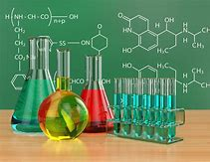
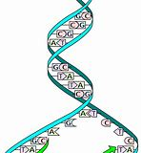
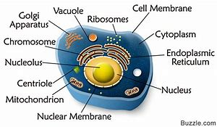
Real Chemistry Doesn’t Support the Origin of Life by Chemical Evolution
OR
“Better Living Through Chemistry”

Slide 2
Many Issues are the Achilles’ Heels of Evolution
Big Band Cosmology – Something from Nothing
Star and Planet formation – Violate gas laws
Fossil Record – Missing links
Genetics – Mutations do not support speciation
Geology – Catastrophic processes
Natural Selection – Genomes adaptive nature
Dating Methods – Assumptions
Human Spirit – Morality, ethics, emotions not physical
Information and Design – Does not reside on matter
Origin of Life – OUR SUBJECT and MOST SIGNIFICANT

Slide 3
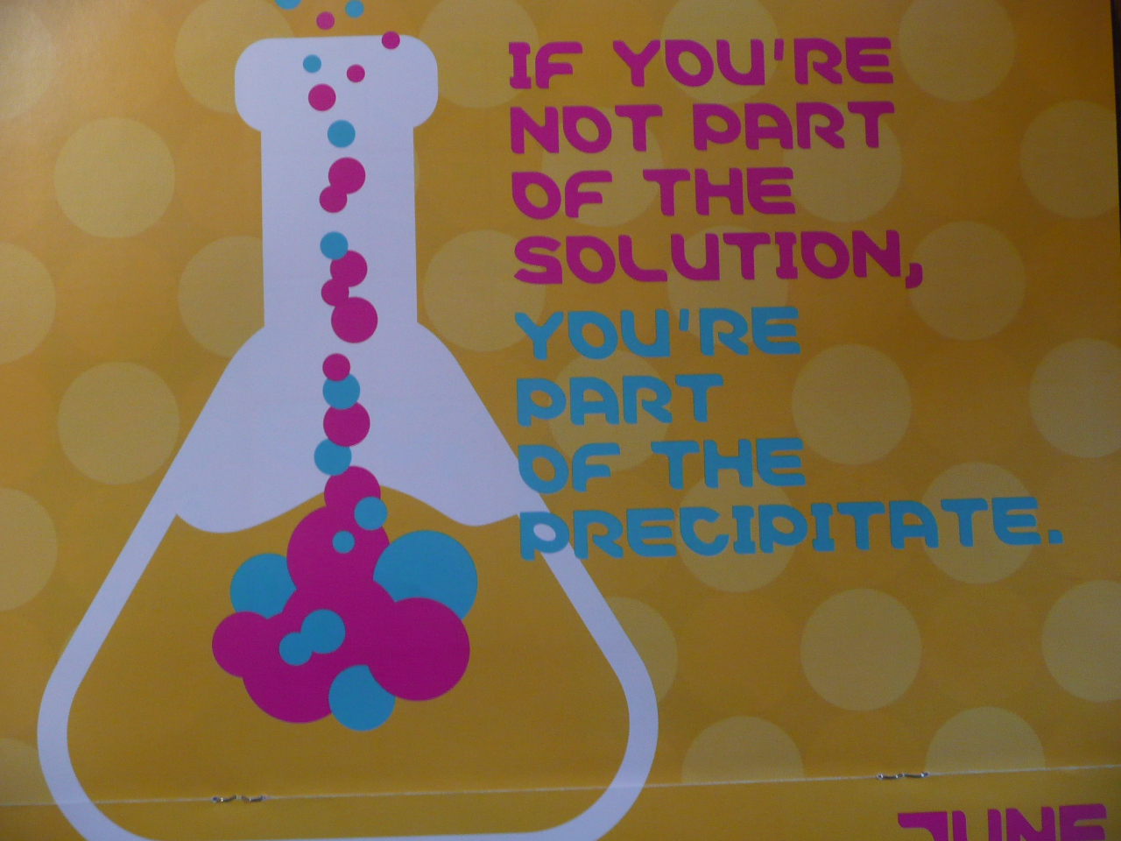
Science is great at finding out how things work, but not good at finding out it started!

Slide 4
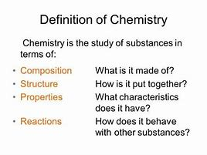
What is Chemistry?

Slide 5
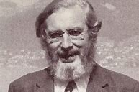
Relationship between Life and Chemistry
Life Rides on Chemistry
“The pure chemistry of a cell is not enough to explain the working of the cell, although the workings are chemical. The chemical workings of a cell are controlled by information that does NOT reside in the atoms and molecules.”
Dr. A.E. Wilder-Smith (1915-1955), noted Swiss professor with 3 earned Ph.D’s in physical organic chemistry, pharmacology and pharmacological sciences. He started out as an atheist and later became a noted Christian creation scientist.

Slide 6

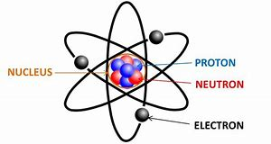



The Model of Evolution
The Earth formed about 4.6 billion years ago. Chemicals formed molecules in a “primordial soup” or at ocean thermal vents. Molecules then bonded together to make living cells.
Formed by
CHANCE over Time
NECESSITY (Natural Laws of Chemical Interaction)
LIFE
Time
Atoms
Chance

Slide 7
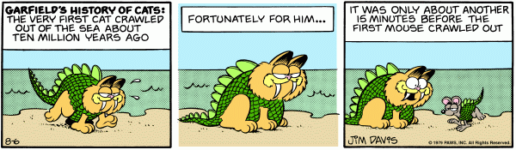
Garfield’s View of
“Evolutionary Origins”

Slide 8
An Evolutionary Viewpoint
“Life arose here on earth from inanimate matter, by some kind of evolutionary process, about four billion years ago. This is NOT a statement of demonstrable fact, but an ASSUMPTION almost universally shared by specialists as well as scientists in general.
It is NOT supported by any direct evidence, nor is it likely to be, but it is consistent with what evidence we do have.”
Frank Harold, Professor of Biochemistry and Molecular Biology at Colorado State, ‘The Way of the Cell”. 2001. p.236

Slide 9
The Model of Creation
“For by him were all things created, that are in heaven, and that are in earth, visible and invisible, whether they be thrones, or dominions, or principalities, or powers: all things were created by him, and for him.”
Colossians 1:16
God created all life

Slide 10
Biology’s biggest challenges.
Many avoid the subject.
Some argue that the origin of life is not part of the theory of evolution – which is not logical, but understandable considering evolutionary origins are at best are inconsistent with and actually contradict real chemical science.
The origin of life is a necessary precursor for all subsequent evolutionary model discussions.
The Critical Nature of the Origin of Life in the Evolution Model

Slide 11
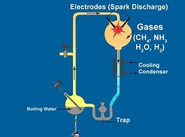
The origin of life remains the theory of evolution's most significant obstacle.
Evolutionists are no closer to solving the riddle of how life began.
Biochemists have been unable show how even the simplest cell could have formed without intelligent cause.
This presentation will examine the origin of life and illustrate that evolution is simply without scientific foundation.
The Purpose of This Presentation

Slide 12
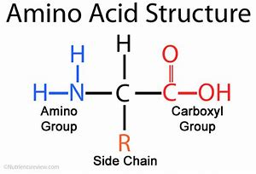
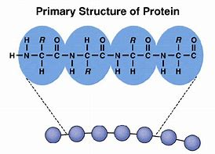
Terminology
Atoms – Basic unit of matter (C, H, O, N, S)
Molecules – Specific arrangement of atoms (water H₂O)
Amino Acids – Molecules used as building blocks for proteins
Side-chain (R) = H or other organic molecules
Proteins – Chains of amino acids bonded together linearly

Slide 13
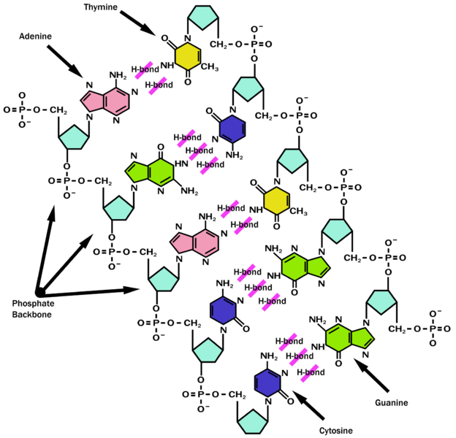
Terminology
DNA – Deoxyribonucleic Acid molecule containing genetic information
3 billion base pairs
6 feet long
De-oxy ribose/phosphate backbone

Slide 14

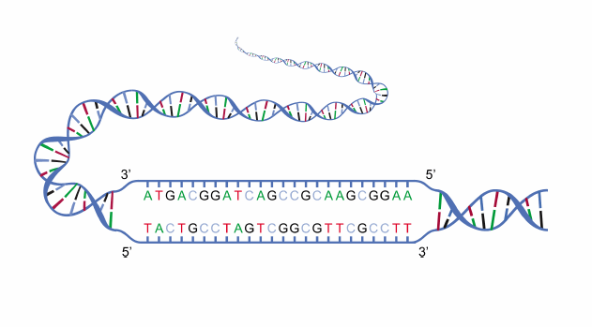
Chromosome
UGC Cysteine
CUG Leucine
AGU Serine
GCA Alanine
DNA
Codon (3-letter Bases for each amino acid)
Gene (for each protein)

Slide 15
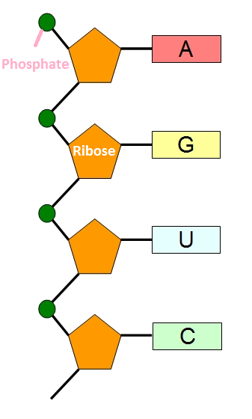
Terminology
m-RNA – Ribonucleic Acid molecule single strand copy of DNA gene for a specific protein
ribose/phosphate backbone
Bases corresponding to the DNA code

Slide 16
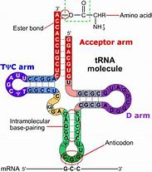
Terminology
t-RNA – Ribonucleic Acid molecule transporting amino acid to m-RNA

Slide 17
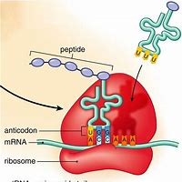
Terminology
r-RNA – Ribonucleic Acid molecule + proteins (RIBOSOME) site for making proteins
Amino Acid
Growing Protein
t-RNA

Slide 18
PROBLEMS

Slide 19
The Information Problem
Information is Everywhere
Does chemical evolution (time + chance) align itself with our knowledge of Information Science?
Definition of CHANCE
Not a thing or entity
Not a active force
Not an agent of causation
Is simply the possibility (probability) of something happening
Is an accidental event
Is to do something by accident or without design
Is an outcomes due to outside forces, actions, laws or entities

Slide 20
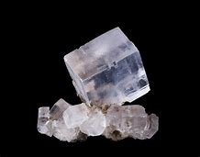
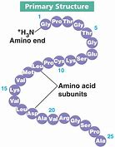
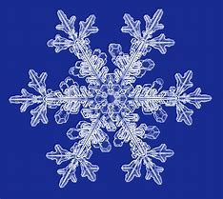
What is Not Information?
Order, Data or Organization?
Determined by physical external constraints.

Slide 21
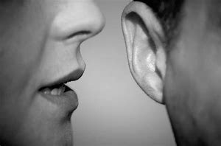
What is Information?
Code, language, knowledge or alphabet that is sent, received and understandable or executable.
SENDER
RECEIVER

Slide 22

Useful Information?
Ability to READ, INTERPRET and EXECUTE the code
Functional and Prescriptive:
Useful
Practical
Instructional

Slide 23
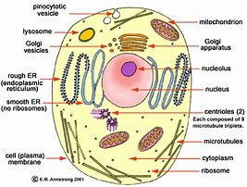
Useful Information?
The cell is full of prescriptive information:
DNA, RNA, proteins and other cellular molecules execute cellular action resulting in meaningful and functional output:
Transportation
Structural work
Complex metabolism
Enzymatic action
Repair
Replication
Waste management
Cellular excretion
Intra-cellular communication

Slide 24


Cellular Software?
atoms/molecules Integrated information system
WHERE DID IT COME FROM?

Slide 25
Teleonomy!
Dr. Wilder-Smith says that Teleonomy rides on the chemicals and chemical processes but does not arise from chemicals themselves or cellular information.
The term derives from two Greek words
τέλος telos ("end, purpose")
νόμος nomos ("law")
Means "end-directed" or "purpose-law".
Teleonomy: the ACTIVE operation program or “force” in living systems:
-not physical but is meta-physical
-programmatic or computational aspects of purpose
-the quality of purposefulness
-goal-directedness of structures

Slide 26

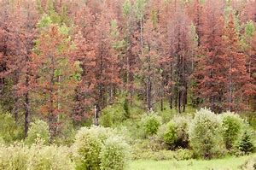
Teleonomy!
Same Chemicals
Same Available Energy
Same Information
Teleonomy Missing

Slide 27
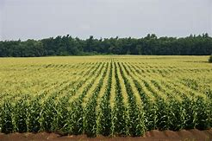
The Cause and Effect World
Chemicals and information are still not enough!
If you wanted to raise corn as a business with a high quality yield, what is needed?

Slide 28

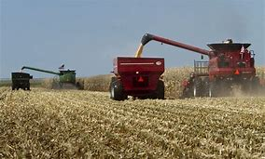
The Cause
1. Farm land, seed, equipment, fertilizer, water, sun …
2. Knowledge of farming techniques and timing
3. A skilled farmer that actually executes the plan
The Farmer is outside the “stuff” needed and the knowledge required.
He uses the stuff to activate and implement the plan

Slide 29
The Cause of Life
1. The “Stuff”: Atoms, molecules, laws, energy …
2. Information: The DNA code
3. A skilled source that actually executes the plan
WHAT OR WHO IS THAT SKILLED SOURCE?

Slide 30
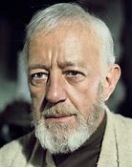

“The Force Be With You”
When the planet Alderaan was destroyed by the Death Star, Obiwan felt a “disturbance in the force”.

Slide 31

“The Real Source of Life”
“Then the LORD formed man of the dust and breathed into his nostrils the breath of life.” Gen 2:7
“As you do not know how the spirit comes to the bones in the womb, so you do not know the works of God who makes everything.” Eccl 11:5
“He is before all things and in Him, all things hold together.” Col 1:17
“…upholding the universe by His word of power.” Heb 1:3

Slide 32
Effect on the Evolutionary Model?
1. There is serious issues with how matter and energy arose out of nothing.
2. The prescriptive information did not originate or was not generated by the chemicals and processes of life.
3. The skilled source required to initiate and maintain life processes does not reside in either the “stuff” of life or the prescriptive blueprint of life.
How does this effect the evolutionary model of origin of life?
Perhaps the model should be modified or abandoned?

Slide 33
IT GETS WORSE

Slide 34
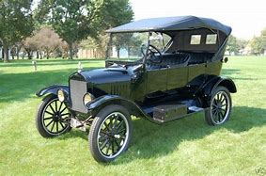
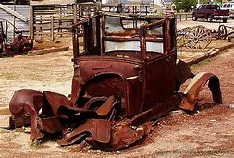
The 2nd Law of Thermodynamics
Problem
Energy goes from a state of usable energy to a state of less usable energy for doing work.
COMPLEXITY
Decay
DISORDER

Slide 35

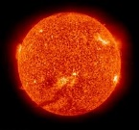

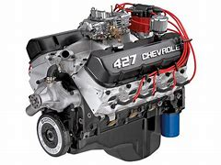
The 2nd Law of Thermodynamics
Applied to Chemical Origins
Four Necessary Conditions to stop the 2nd Law from hindering the formation of simple to extremely complex biological molecules and systems:
1. An open system (the earth)
2. Energy source (the sun or other terrestrial source)
3. A way to capture and store the raw available energy
4. An energy conversion system
Problem:
Outside the cell and before existing cellular processes were in place – in the ocean or “primordial soup”, conditions 3-4 did not exist.

Slide 36
The 2nd Law of Thermodynamics
Applied to Chemical Systems
“A fundamental that science has never been able to solve is how to produce energy flow through the system to do this work of coding to produce, for example, a functioning protein.
Living systems do, of course, harness energy for this purpose, but only because the required, purposefully assembled metabolic pathway is already in place and functioning.”
Neil Broom (Ph.D., Chemical and Materials Engineering),
“How Blind is the Watchmaker, 2001, p. 80

Slide 37
IT GETS WORSE

Slide 38
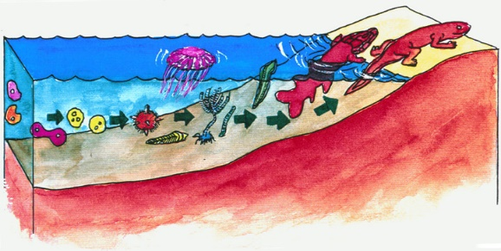
The Hydrolysis Problem
So where and how did it start?
Did it start in the ocean?
How about a primordial pond?
Pond Scum?
The ocean or a primordial pond is the worst place for life to start due to HYDROLYSIS

Slide 39
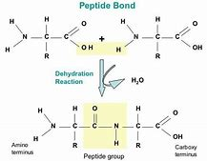
The Hydrolysis Problem
Proteins are formed when amino acids bond together during a DE-HYDRATION process
Peptide Bond Formed
Un-fortunately, it is a reversible reaction

Slide 40
The Hydrolysis Problem
Un-protected proteins are broken apart during a HYDRATION process in the presence of water
H₂O
Peptide Bond
Broken
Oceans and ponds, especially at elevated temperatures are hard on proteins.
They are protected in the cellular environment.

Slide 41
IT GETS WORSE

Slide 42

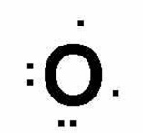
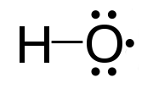
The Oxygen Problem
Life cannot start with oxygen in the atmosphere – Oxygen RADICALS in the environment rapidly breaks down molecules (like proteins and DNA) without cellular protections.
Life cannot start without oxygen in the atmosphere – Oxygen is a key requirement in the respiration and metabolic processes.

Slide 43
IT GETS WORSE

Slide 44
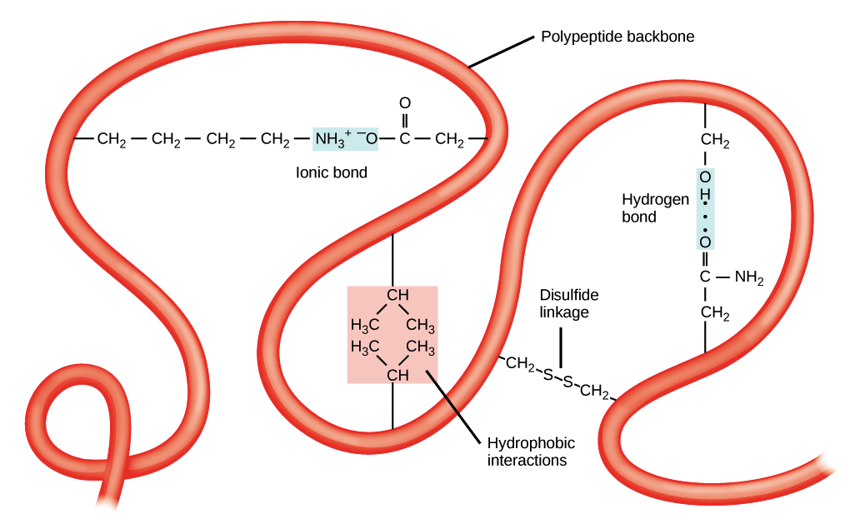
Side-Chain Interaction
Un-protected protein side-chains (-R groups) can pre-maturely fold, deactivating the protein.

Slide 45
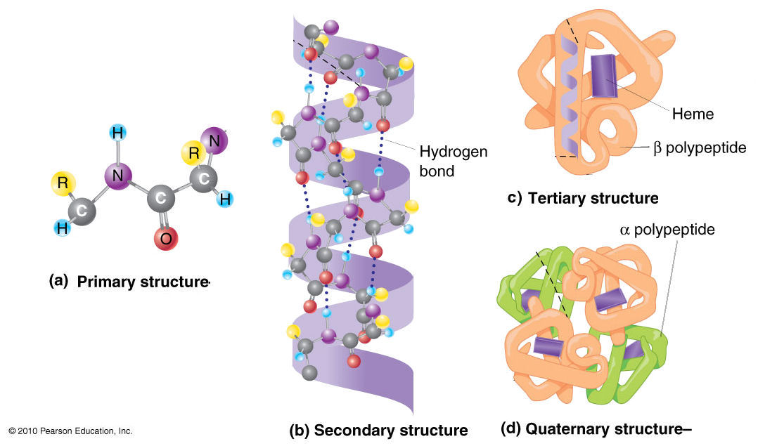
Complex Folding
Proteins are folded inside cellular Golgi Bodies to direct complex enzyme formation

Slide 46
IT GETS WORSE

Slide 47

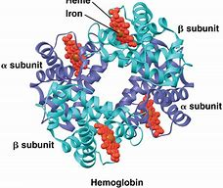
Interaction with the Chemical Environment
Un-protected amino acids, proteins, DNA and RNA and other biologically active molecules can react randomly with other chemicals in the ‘primordial soup’ environment destroying or deactivating the active molecules or preventing their formation in the first place.

Slide 48
IT GETS WORSE

Slide 49
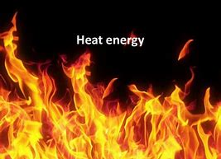

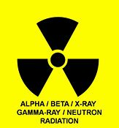

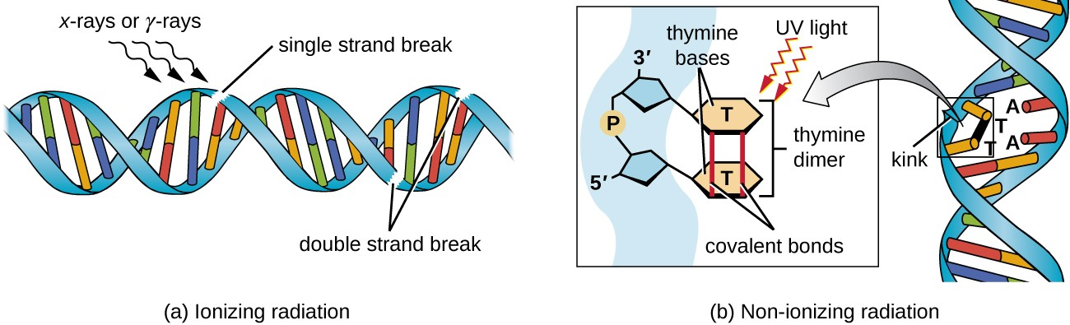
Damage from the Physical Environment
In the external environment, no repair mechanism is at work.
Our DNA is damaged in hundreds of locations every day. Repair enzymes (proteins) and mechanisms are constantly at work.

Slide 50
IT GETS WORSE

Slide 51
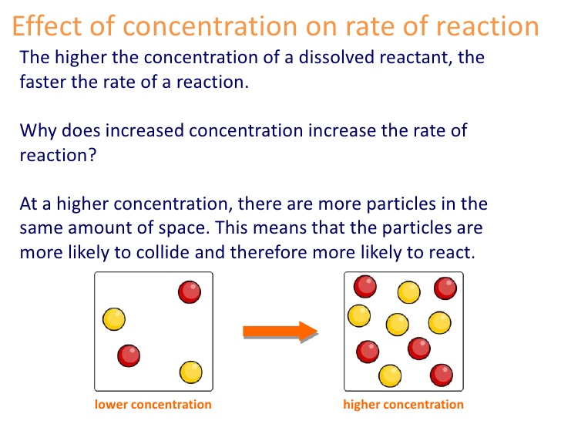
Concentration Problem
In an open environment, there is no mechanism to control the concentration of molecules and the molecules are too dilute to react together in effectively

Slide 52
IT GETS WORSE

Slide 53
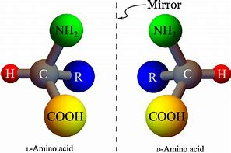
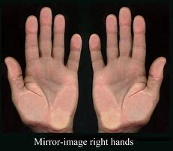
Left and Right Handed Amino Acids
Amino acids come naturally in left and right versions (50/50), but all amino acids in proteins in cells are left-handed only.

Slide 54
Proteins formed in an open Environment
Proteins in an open environment would made of left- and right-handed amino acids.
Mixed handedness would cause proteins to not be biologically active: unable to fold into the right shapes to act as enzymes.
Cellular proteins are all left-handed and are formed that way since DNA and RNA are all right-handed which allows the cell to function efficiently.
Left or right hand only 3-D molecular structure is impossible to form in the un-protected external environment.
Proteins
DNA
RNA

Slide 55
Left-Right Amino Acids Act Chemically the SAME
Outside the cell, there is no mechanism to distinguish between left and right-handed amino acids when making proteins.
Outside the cell, amino acids are a 50 – 50 mixture. How could one expect a typical 150 – 250 unit protein chain to be exclusively left-handed?
The de-oxy ribose/phosphate DNA backbone also naturally comes in mixed handedness. How could a
3-billion long chain be exclusively right-handed?
Not outside the cell for sure, but inside the cell, a definite YES! A design miracle? YES!

Slide 56
IT GETS WORSE

Slide 57
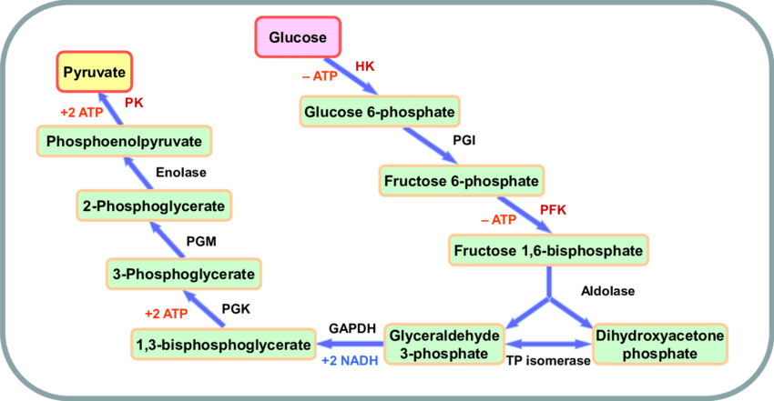
Irreducible Complexity Problem
Example: Cellular Metabolism
(Energy Conversion Mechanism)
Step 1
Glycolysis
Requires
10 protein enzymes
2 ATP energy sources to start

Slide 58
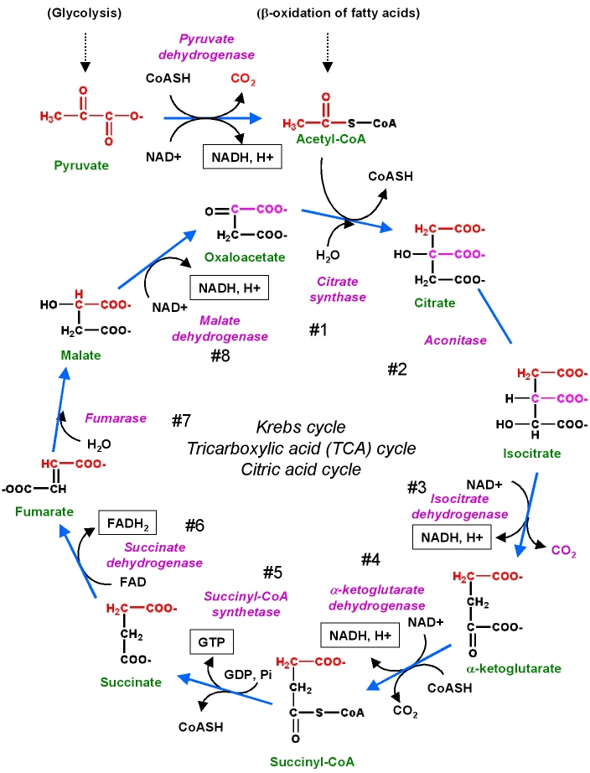
Irreducible Complexity Problem
Example: Cellular Metabolism
(Energy Conversion Mechanism)
Requires
10 protein enzymes
And other reactants
Step 2
Krebs Cycle

Slide 59
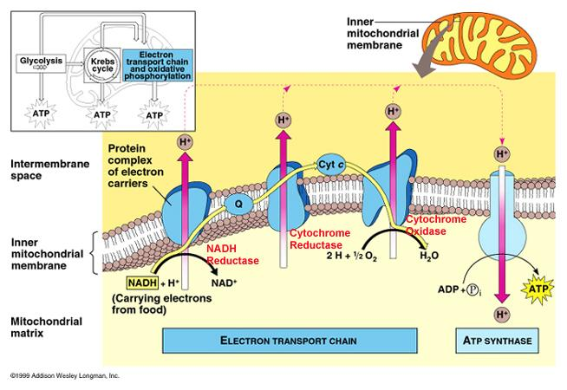
Irreducible Complexity Problem
Example: Cellular Metabolism
(Energy Conversion Mechanism)
Step 3 – Electron Transport Chain
ATP Produced as the cell’s energy source
Requires
4 extremely complex protein enzymes
inside the mitochondria

Slide 60
Irreducible Complexity Problem
How Critical is Each Step?
In the 22nd step
CN poisioning inactivates Cytochrome Oxidase Enzyme and YOU DIE!
X

Slide 61
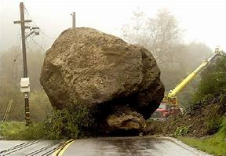
Irreducible Complexity Problem
Example: Cellular Metabolism
(Energy Conversion Mechanism)
All the protein enzymes, other required reactants, a functioning complex mitochondria cellular organelle, other cellular structures and even the end product ATP energy unit are all required to be in place in order for cellular metabolism to work.
Remove one enzyme, one ATP or one reactant and the road to life is blocked.
All this the product of random non-directed chemical reactions in a deadly “primordial soup”?
Beyond all scientific reason!

Slide 62
IT GETS WORSE

Slide 63
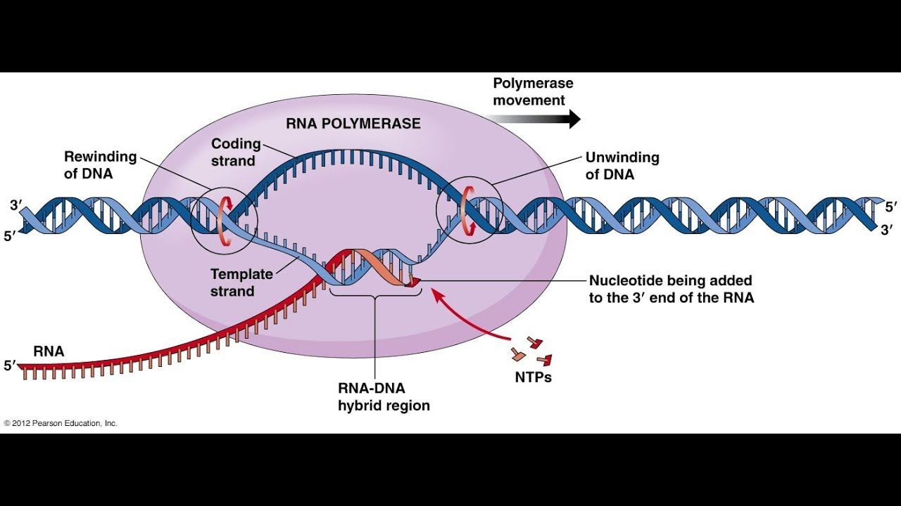
The Chicken or the Egg Problem
Example: Protein Formation

Slide 64
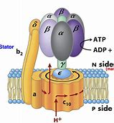
ATP Synthase
Energy Source Cellular Processes
ATP
20 protein
enzyme
complex
Rotates at 10,000 rpm
From Glucose Breakdown

Slide 65
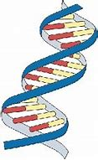
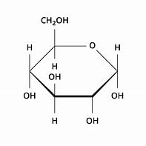
Which Came First?
ATP Synthase
Glucose provides energy to ATP synthase
DNA makes ATP synthase
Glucose
2 ATPs required to breakdown glucose
ATP required for DNA to make ATP Synthase
ATP

Slide 66
IT GETS WORSE

Slide 67

Probability (Chance) Problem
What are the chances of getting heads every time you flip a penny?
1 in a row 1:2
2 in a row 1:4
3 in a row 1:8
8 in a row 1:256
100 in a row 1:10³⁰

Slide 68



Probability and Life Problem
What are the chances of getting a biologically active molecules?
Protein 150 amino acids long 1:10¹⁶⁴
DNA Sequence 1:10^{4,000}
The simplest cell 1:10^{40,000}
Any event with a probability over 10⁵⁰ is from a practical point of view is not possible!

Slide 69
Where does all the chemical evidence lead?
Einstein, though not claiming to be a Christian, concluded that “… the universe, (and therefore biology), must have its origin in understanding, thought, concept, mathematics, intelligence and teleonomy and not in randomness – chance plus the inanimate laws of nature.”
“… for to him (Einstein) the greatest miracle in the universe was that we can at least in part comprehend it”
A.E. Wilder-Smith, “He Who Thinks Has To Believe), 1981
Another Viewpoint . . .
Notes:
Now that we have an understanding of the foundation of evolution… Why is evolution without a foundation? Because there is no natural process that can cause life to originate
Note: don’t let the argument go anywhere until they can explain their foundation for the origin of life. They have to accept it by faith.

Slide 70

Leading Atheist Richard Dawkins’ View

Slide 71



Richard Dawkins Take on Origins
Stein: How did life start?
Dawkins: I have no idea how it started. Perhaps it was seeded on earth by a higher (alien) intelligence.
Richard Dawkins interviewed by Ben Stein; “Expelled” 2008
The Aliens Did It?

Slide 72
THINK: What Does All This Mean?
Since any biological change is dependent on life FIRST originating by natural processes violating basic chemical laws, the entire model of evolution is without a foundation.
“Why should I accept evolution when you cannot produce the evidence?
I already have a faith. Tell me about your faith and I will tell you about my faith.” (Mike Riddle)
Therefore . . .
Notes:
Now that we have an understanding of the foundation of evolution… Why is evolution without a foundation? Because there is no natural process that can cause life to originate
Note: don’t let the argument go anywhere until they can explain their foundation for the origin of life. They have to accept it by faith.

Slide 73

Logical Deduction
Your Christian Faith - It is rational (reasonable) to believe that God, not unknown events, created life.

Slide 74
TAKEAWAYS
1. Origin of Life is Foundational
2. No Evolutionary Pathway to Life (violates and contradicts chemical, physical, probability and informational laws)
3. Design, Intelligence and Information Drive Life (outside of chemistry)
4. Chemistry of Life Confirms God as the Creator (the cause)

Slide 75

Remember Our Task
Be prepared to make a solid defense to those who challenge our faith
2 Tim 3:15

Slide 76

Ask Critical Questions
How do you know it is true?
Has it ever been observed?
Are you making any assumptions?

Slide 77




Rom 1:20, 23
Ever since the creation of the world His invisible nature, namely His eternal power and deity, has been clearly perceived in the things that have been made, so they are without excuse … and exchanged the glory of the immortal God for images …
THINK

Slide 78






How to Prepare
Read creation science books, magazines and articles
Watch creation science DVDs
Attend creation science classes
Attend creation science conferences
Attend creation science meetings
Go on creation science field trips
Visit creation science museums

Slide 79




How to Start
Subscribe to Institute for Creation Research (ICR) “Acts and Facts” and visit ICR online
Visit Answers in Genesis (AIG) online
Visit NWCreation.net or the Snohomish County Apologetics Forum to learn about local monthly creation science seminars and meetings (events and links. Meetings held monthly in Arlington, Bothell, Montlake Terrace, Bellevue, Federal Way, Portland, Yakima, Tri-Cities and others.
Start a library of good creation science books and DVDs
Visit the Mt. St. Helens Creation Center

Slide 80

Consider a Summer Family Field Trip
Mt. St. Helens
Dry Falls

Slide 81
Psalm 118:8
It is better to take refuge in the Lord than to put confidence in man.
Psalm 111:2
Great are the works of the Lord, studied by all those who have pleasure in them.

